Slide 1
PetRescuesByEmily.com
Private Review Archive for GoDaddy Office of the CEO
Prepared by Margaret Scott Lynch
ZebraMultimedia / MaggieTheGeek
GoDaddy Case: DCU101180266 • ICANN Case: 01581431
Recovering Domain: PetRescuesByEmily.com By Margaret Scott Lynch / ZebraMultimedia / MaggieTheGeek@gMail.com / Submitted 20260511 / Slide #

Slide 2
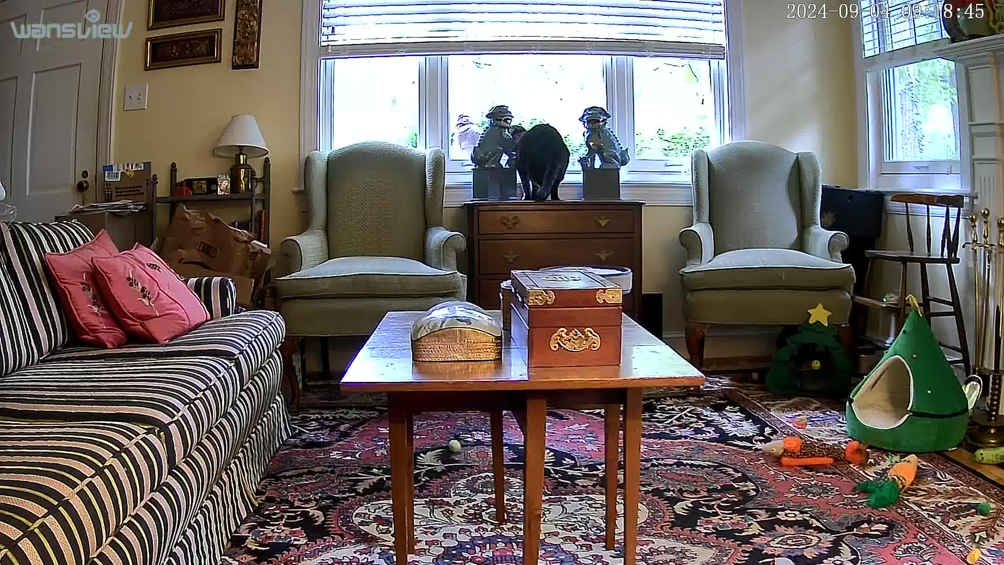
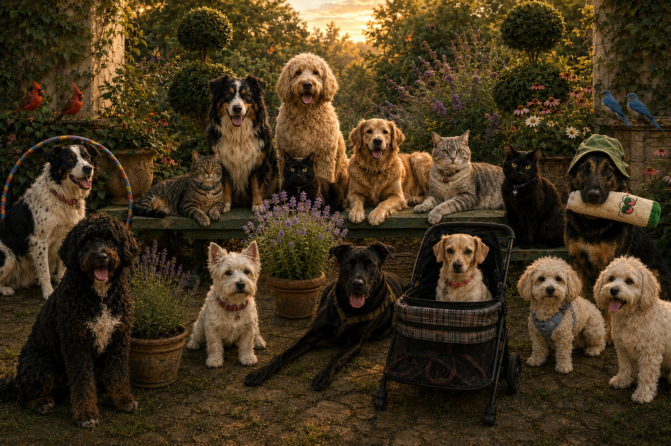
Meet Margaret Scott Lynch — MaggieTheGeek
The accidental cat mom.
A self-described "doggie mom," Margaret became a cat rescuer almost by accident and has never looked back.
🐱 Lloyd arrived during COVID when his human began a retina surgery residency in a one-bedroom high-rise. Lloyd was miserable. He needed a home.
🐱 Stella arrived April 4, 2024 — about a month after her human mom died from leukemia. Stella had been an outside cat who wanted to be an only child.
What followed: 2 six-foot gates, repurposed glass dining room doors, Wansview security cameras throughout the house, hemp oil, industrial quantities of cat mint — and two full years of patience.
Oh — and Margaret is allergic to cats. That's what allergy meds are for.
"My rescue animals kept me so busy they never made it to Emily's site. That's what real rescue work looks like."
Wansview Cat Cam • Sep 4, 2024 — Stella hides between antique Foo Dogs to ambush Lloyd through the window.
Mother's Day 2025 — from Stella, Lloyd and The Fam 🐾

Slide 3
A Loyal GoDaddy Customer — 72 Domains and Counting
72
Margaret Scott Lynch is not a casual GoDaddy user. She has maintained 72 combined domain names — each purchased with intention. Her rescue-related portfolio alone demonstrates a clear, established pattern of purpose:
DOMAINS
petrescuesbyemily.com • petrescues.info • petrescues.us • petrescues.shop • petrescues.store • georgiarescues.shop • georgiarescues.store • maggiethecatlady.com
nbshs.com
myzmusic.com
myzmall.com
mrsclaus.ai
maggiethegeek.us
maggiethegeek.com
maggiethegeek.ai
leopardskinproductions.com
leakygutsyndrome.ai
karmaismypitbull.com
iwantmorecowbell.com
healthpointsacupuncture.com
grabandgoboxes.com
goddessofgeeks.com
fourwisebyrdes.us
fourwisebyrdes.com
fourwisebirds.com
fireballtherapy.com
doubledowndon.com
craftstore.ai
clickheresanta.com
caryacupuncture.com
zpartyanimals.com
zmallz.com
zebramultimedia.net
zebramultimedia.ai
zdiscountdomains.com
wiseowlcalligraphy.com
williamsburgantiques.com
thebookofduh.com
shopsatthemall.com
secretsantashopping.com
partystore.ai
originallyscott.com
zebramultimedia.com
buildingtraintracks.info
raleighnc.info
petrescues.info
petrescues.us
raleighnc.pro
buildingtraintracks.shop
buildingtraintracks.store
georgiarescues.shop
georgiarescues.store
newbernnc.shop
newbernnc.store
petrescues.shop
petrescues.store
raleighnc.store
traintracks.online
traintracks.shop
traintracks.store
zebramultimedia.us
mrsclaus.live
mrsclaus.world
mrsclaus.life
mrsclaus.biz
mrsclaus.co
mrsclaus.fun
mrsclaus.store
maggiethecatlady.com
★ Rescue-related domains shown in green • This portfolio demonstrates decades of intentional domain stewardship with GoDaddy.

Slide 4
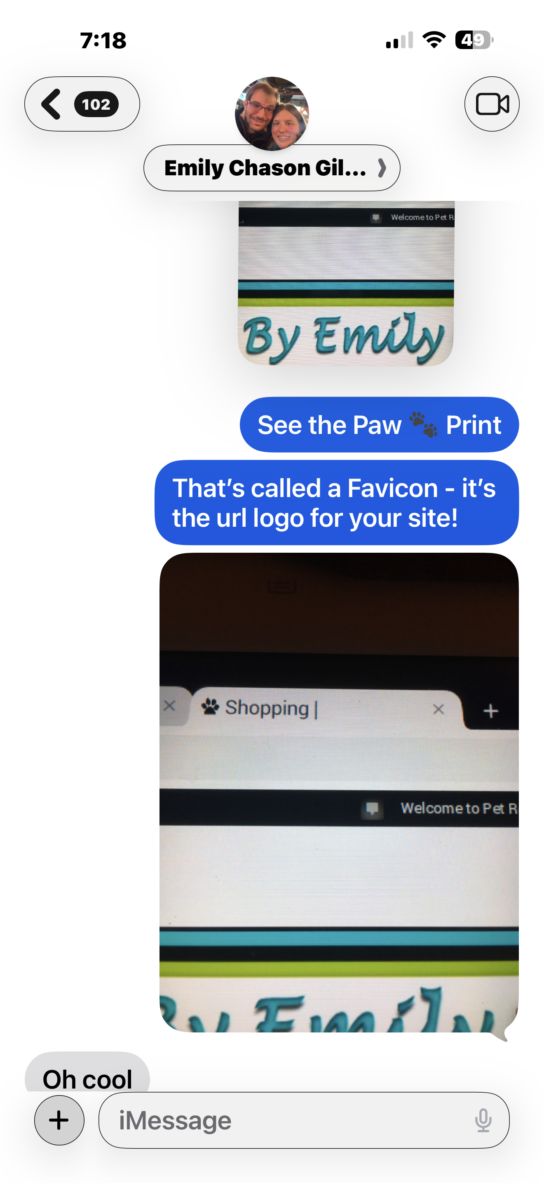
GoDaddy's Own Rules — The Squatter Violated Every One
THE EVIDENCE — WHAT'S STILL IN THE SQUATTER'S CODE
GODADDY'S OWN TOS — WHAT THEY CAN DO NOW
© 2019 Copyright notice — visible in the page footer AND embedded in source code. The squatter is running a site that still displays Emily's own copyright. They didn't even remove it.
File Manager upload dates: ALL 2019 — every content file timestamps back to Emily's original hosting. The squatter created nothing.
Custom Paw Print Favicon — designed by ZebraMultimedia / MaggieTheGeek, texted to Emily on May 31, 2019 (iMessage documented). Still present in the squatter's file directory today. Original IP belonging to ZebraMultimedia — no license was ever granted.
Source code file paths: /wp-content/uploads/2019/ — the squatter's code still references Emily's original WordPress directory structure. This is not a coincidence. This is proof of wholesale content scraping.
SSL Certificate — this was a live, professional, actively maintained website. Not a parked placeholder. Not an abandoned domain.
GoDaddy Universal TOS requires every user to have "all necessary rights to distribute User Content." The squatter cannot meet this standard.
Prohibited (GoDaddy TOS): "trademark or copyright infringement, fraudulent or deceptive practices."
Consequence (GoDaddy TOS): "suspension of the Domain Name."
GoDaddy Trademark/Copyright Policy — GoDaddy has authority RIGHT NOW to:
✓ Lock down the domain name
✓ Redirect the DNS
✓ Suspend the infringer's account
✓ Permanently remove infringing material
Wild West Domains = GoDaddy. IANA ID 440. Wholly owned subsidiary. Same TOS. Same authority. Same responsibility.
GoDaddy's own blog (May 2026) defines this as cybersquatting: "bad faith... no real connection to the domain."
"For a site with years of original content, SSL certification, a custom favicon, and significant GoDaddy storage — did Emily not deserve one human phone call before her site went to auction?"
THE ASK: Enforce your own Terms of Service. The tools are already in your hands.
iMessage to Emily — May 31, 2019

Slide 5
Table of Contents
SECTION 1 — OVERVIEW & CONTEXT
Legacy Website Source Code — view-source:petrescuesbyemily.com
37
Purpose of This Archive
2
Wayback Machine Continuity
14
A Note on This Submission
3
SECTION 4 — GODADDY RELATIONSHIP & FILINGS
Important Context
5
GoDaddy Customer Relationship — Active Account Documentation
13
Visual Evidence Overview
6
Tangible Marketing — Emily's Business Cards
35
SECTION 2 — EMILY & BRAND IDENTITY
Closing Request
15
Emily IS Pet Rescues By Emily — Contact Name Confirms It
7
SECTION 5 — PHOTOS, SCREENSHOTS & CORRESPONDENCE
Emily's Online Identity — Brand Continuity Evidence
10
Snippet of Photos and Screenshots
36
Emily's Facebook — Active Rescue Advocate, Live Website Link
11
iMessage Threads — Health Crisis & Website Context
47
Emily's iMessage — Planned Website Updates
17
Email Correspondence — Cybersquatting Acknowledgment
43
SECTION 3 — CONTINUITY EVIDENCE
Interruption of Legacy and Posthumous Online Grieving
53
Current Website State — All Original Content Intact
8
SECTION 6 — IN MEMORIAM
Original Upload Continuity
9
The Rainbow Bridge — A Note on Its Meaning
54
Theme & Source-Code Continuity
12
Jill & Zoie — Rainbow Bridge Tribute
55
Recovering Domain: PetRescuesByEmily.com By Margaret Scott Lynch / ZebraMultimedia / MaggieTheGeek@gMail.com / Submitted 20260511 / Slide # 1 of 58

Slide 6
Purpose of This Archive
Public Evidence Archive Reference
This presentation is intended as a supplemental private review archive accompanying the already-published evidence compilation located at:
http://www.maggiethegeek.com/cyber-squatter-complaint/
The public archive contains:
additional screenshots,
timeline materials,
continuity documentation,
Wayback captures,
and supporting contextual evidence referenced throughout this presentation.
This PowerPoint is intended to provide a more concise executive-review narrative highlighting the most significant continuity and human-impact issues surrounding PetRescuesByEmily.com.
Recovering Domain: PetRescuesByEmily.com By Margaret Scott Lynch / ZebraMultimedia / MaggieTheGeek@gMail.com / Submitted 20260511 / Slide #

Slide 7
A Note on This Submission
Quite frankly, the overall organization, formatting and final production quality of this archive fall far below my normal professional standards. Under ordinary circumstances, I would have preferred substantially more time for proofreading, visual consistency, formatting review, sequencing verification and technical refinement. However, due to the cumulative impact of 16 months of recovery from eight surgeries, another upcoming surgery scheduled for May 28, ongoing visual and vestibular complications, repeated illness, household disruption, interrupted sleep and continual efforts to preserve and organize evidence before additional information was lost, I ultimately made the decision that submitting an imperfect but comprehensive archive was preferable to risking further delay or incomplete preservation of important materials and continuity evidence.
Recovering Domain: PetRescuesByEmily.com By Margaret Scott Lynch / ZebraMultimedia / MaggieTheGeek@gMail.com / Submitted 20260511 / Slide # 1 of 58

Slide 8
Purpose of This Archive
Consolidated private review archive
Visual continuity evidence
Original WordPress hosting continuity
Source-code continuity observations
Wayback Machine continuity
Rescue platform history and context
Recovering Domain: PetRescuesByEmily.com By Margaret Scott Lynch / ZebraMultimedia / MaggieTheGeek@gMail.com / Submitted 20260511 / Slide #

Slide 9
Important Context
The first and biggest mistake was all mine and was the missed renewal of PetRescuesByEmilly.com during a documented health crisis including extensive visual impairment including severe vision changes, reoccurrence of double ptosis, undiagnosed cataracts and undiagnosed retina membrane scar tissue.
As I was preparing for upcoming surgeries, I did a bulk domain renewal of numerous domains and initially, PetRescuesByEmily.com was in the renewal cart.
The second mistake was when on or about the same time, the updated eMail address for my Registrant Account to a more monitored eMail instead of one laden with spam did not properly update during the same health crisis
This was not an abandoned placeholder domain
The website represented years of active rescue advocacy and original content
The current disputed site continues displaying substantial continuity with the original platform
Recovering Domain: PetRescuesByEmily.com By Margaret Scott Lynch / ZebraMultimedia / MaggieTheGeek@gMail.com / Submitted 20260511 / Slide #

Slide 10
Visual Evidence Overview
This section visually demonstrates continuity between:
Original 2019 hosting environment
Original uploads and filenames
Original mascot images
Original theme structure
Current disputed source-code references
Archived Wayback Machine captures
Violation of Intellectual Property Rights
Common Law Trademark and Name Brand Infringement
Recovering Domain: PetRescuesByEmily.com By Margaret Scott Lynch / ZebraMultimedia / MaggieTheGeek@gMail.com / Submitted 20260511 / Slide #

Slide 11
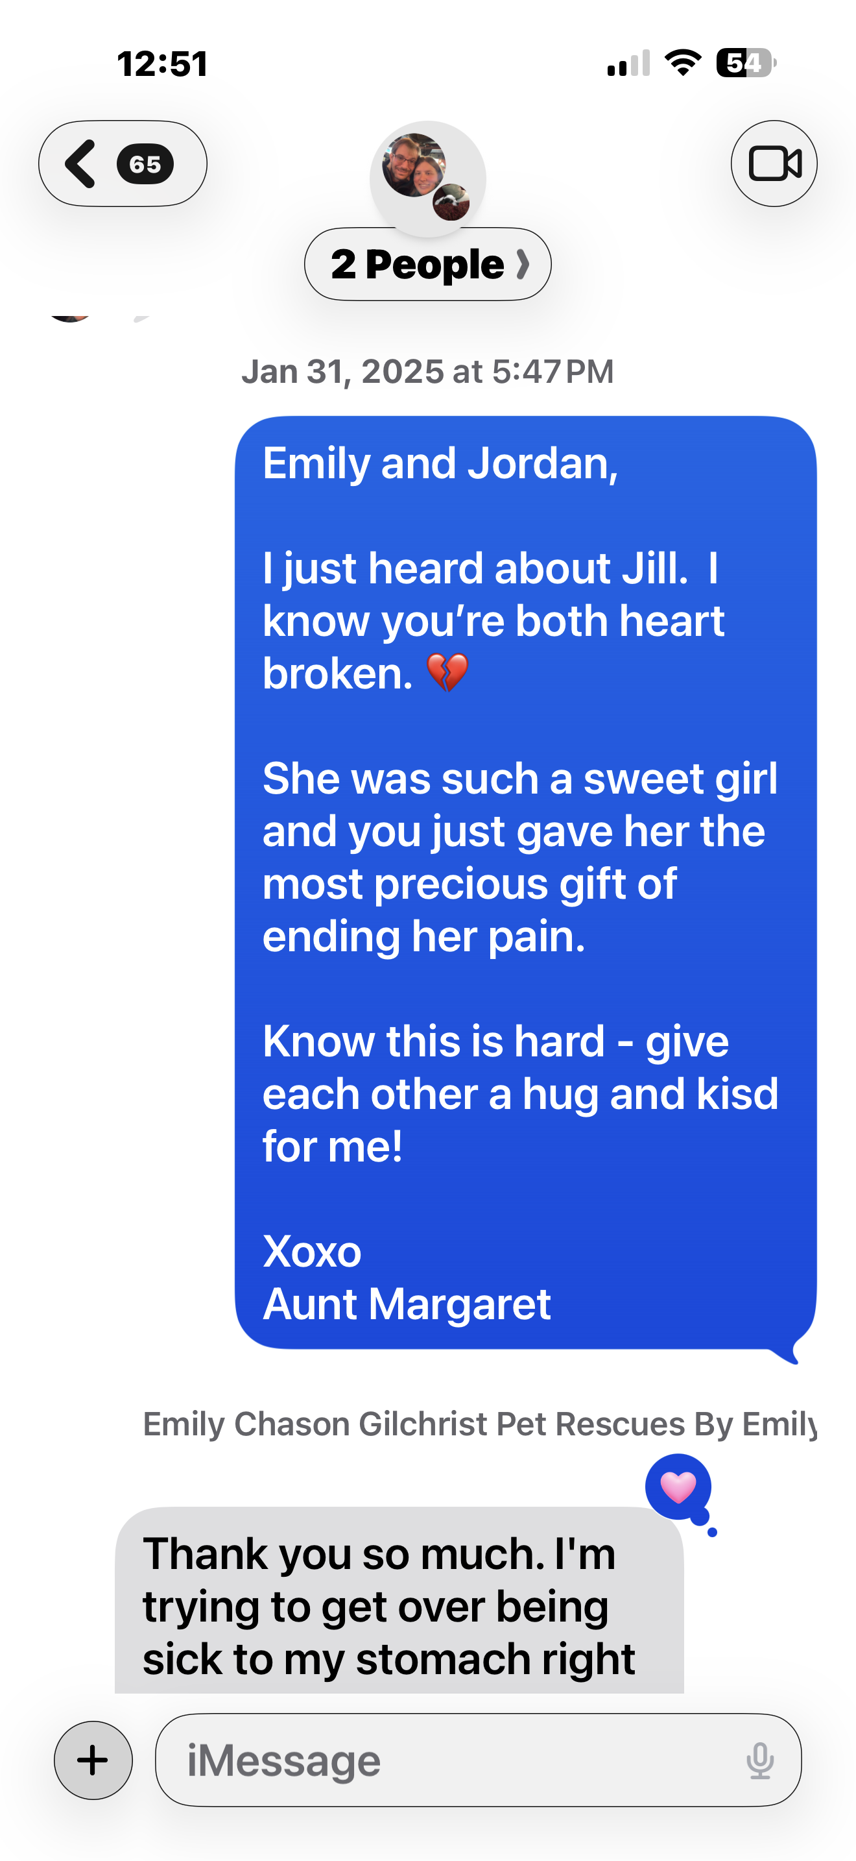
Emily IS Pet Rescues By Emily — Her Own Contact Name Confirms It
What This Screenshot Proves:
Emily's contact is saved as "Emily Chason Gilchrist Pet Rescues By Emily" — connecting her name directly to the stolen domain.
Her replies are labeled "Sent with Siri" — corroborating her documented legal blindness since age 6 months.
Jill and Zoie — both named in the stolen site's "Happy Tails" navigation — were Emily's real rescued dogs. Jill died January 31, 2025. Zoie followed in February 2025.
The cybersquatter continues profiting from a site whose dogs Emily rescued, loved, and lost.
iMessage thread — Jan. 31, 2025 | Contact: "Emily Chason Gilchrist Pet Rescues By Emily"
Recovering Domain: PetRescuesByEmily.com By Margaret Scott Lynch / ZebraMultimedia / MaggieTheGeek@gMail.com / Submitted 20260511 / Slide #

Slide 12
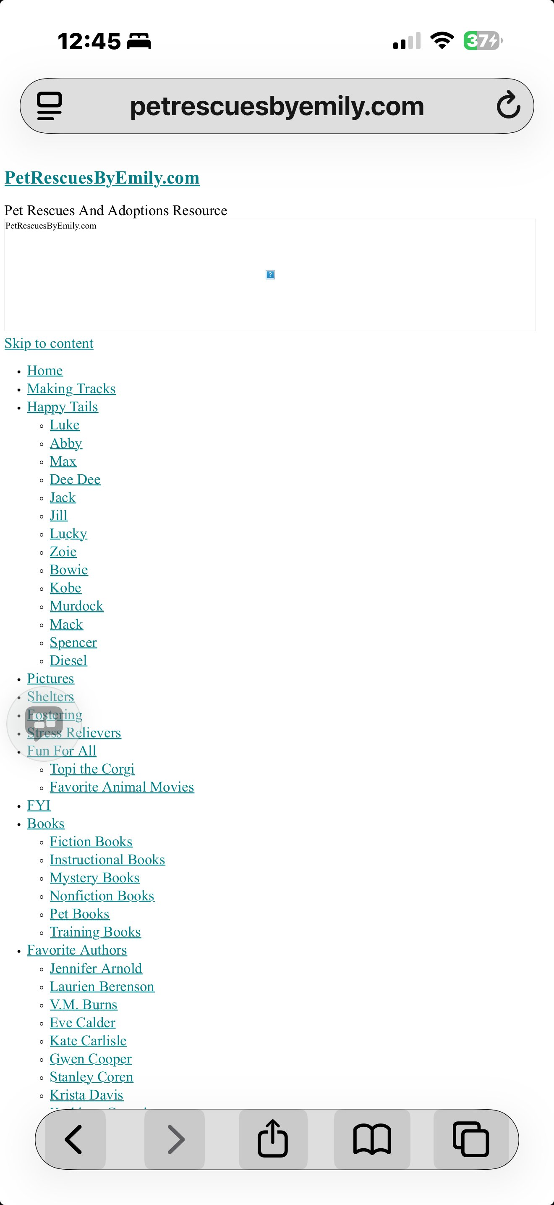
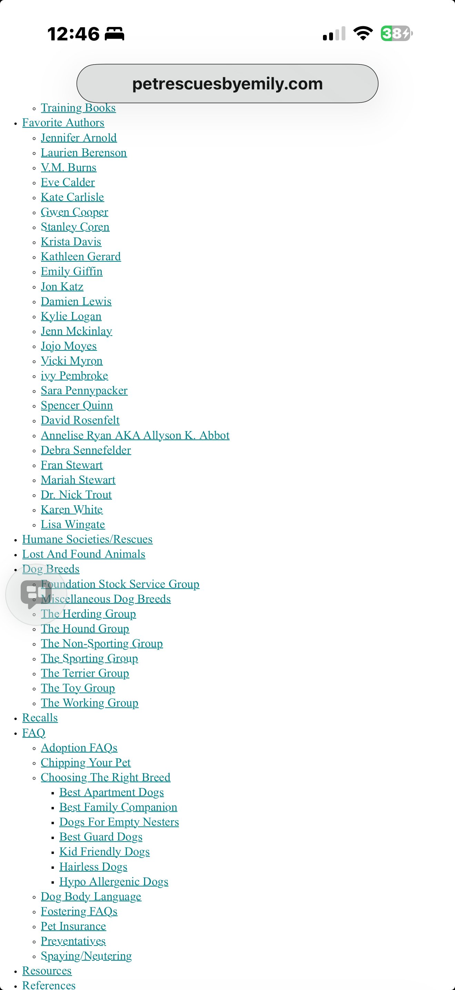
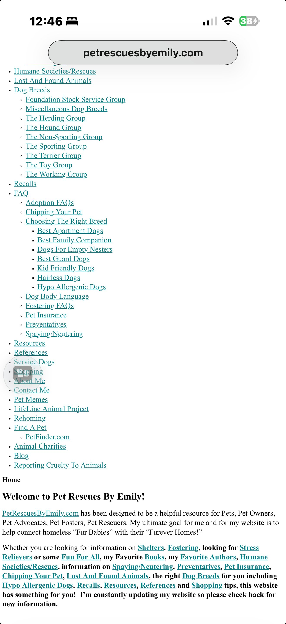
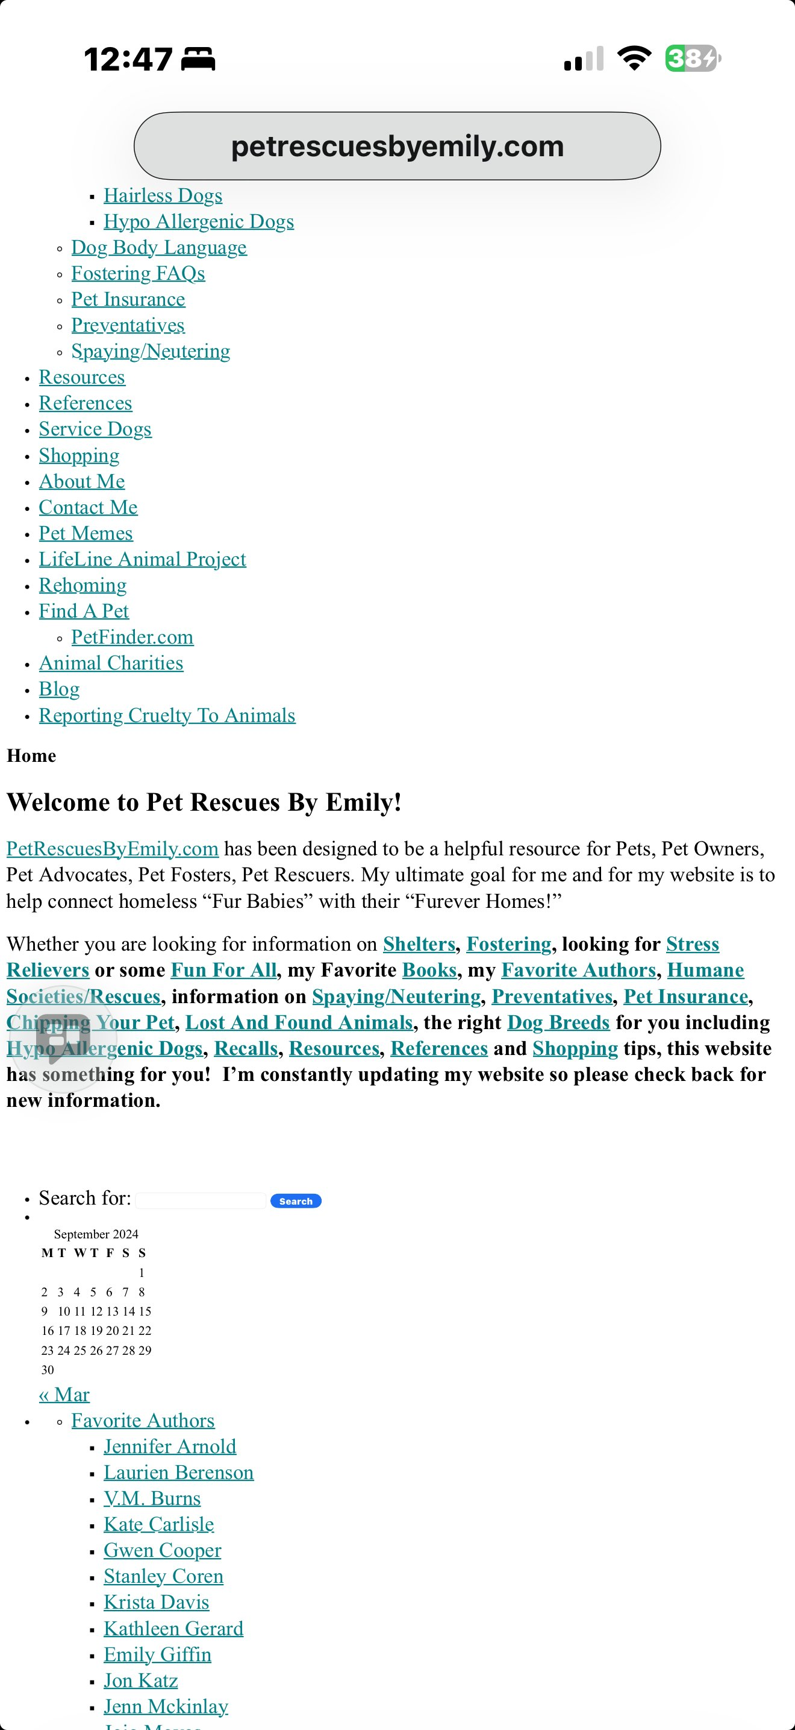
Current Website State — All of MY Original Content Intact
All four captures taken live — original navigation, all original content, and Maggie's copyright notice remain intact under the squatter's control.
Recovering Domain: PetRescuesByEmily.com By Margaret Scott Lynch / ZebraMultimedia / MaggieTheGeek@gMail.com / Submitted 20260511 / Slide #

Slide 13
Original Upload Continuity
/wp-content/uploads/2019/04
/wp-content/uploads/2019/05
Jill and Zoie image continuity
Making-Tracks-www.PetRescuesByEmily.jpg
Recovering Domain: PetRescuesByEmily.com By Margaret Scott Lynch / ZebraMultimedia / MaggieTheGeek@gMail.com / Submitted 20260511 / Slide #

Slide 14
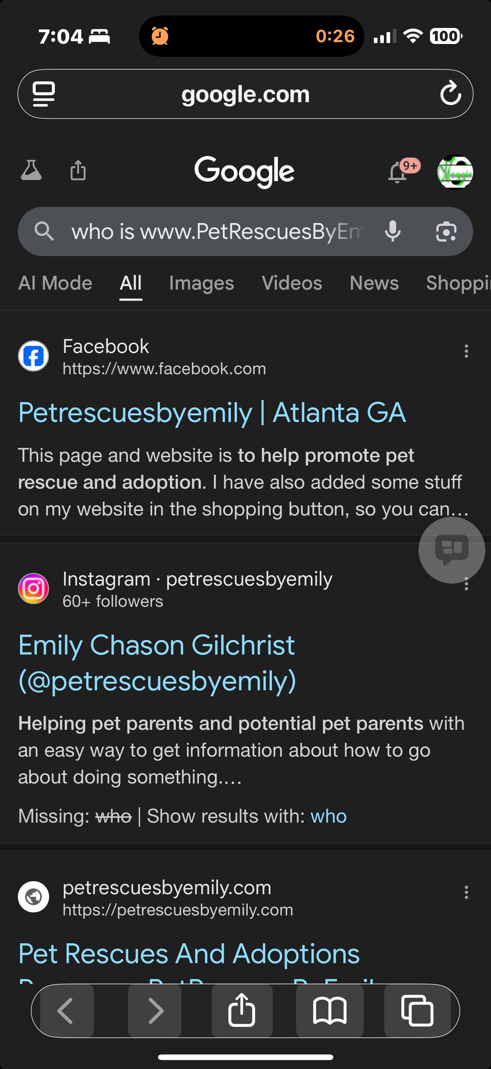
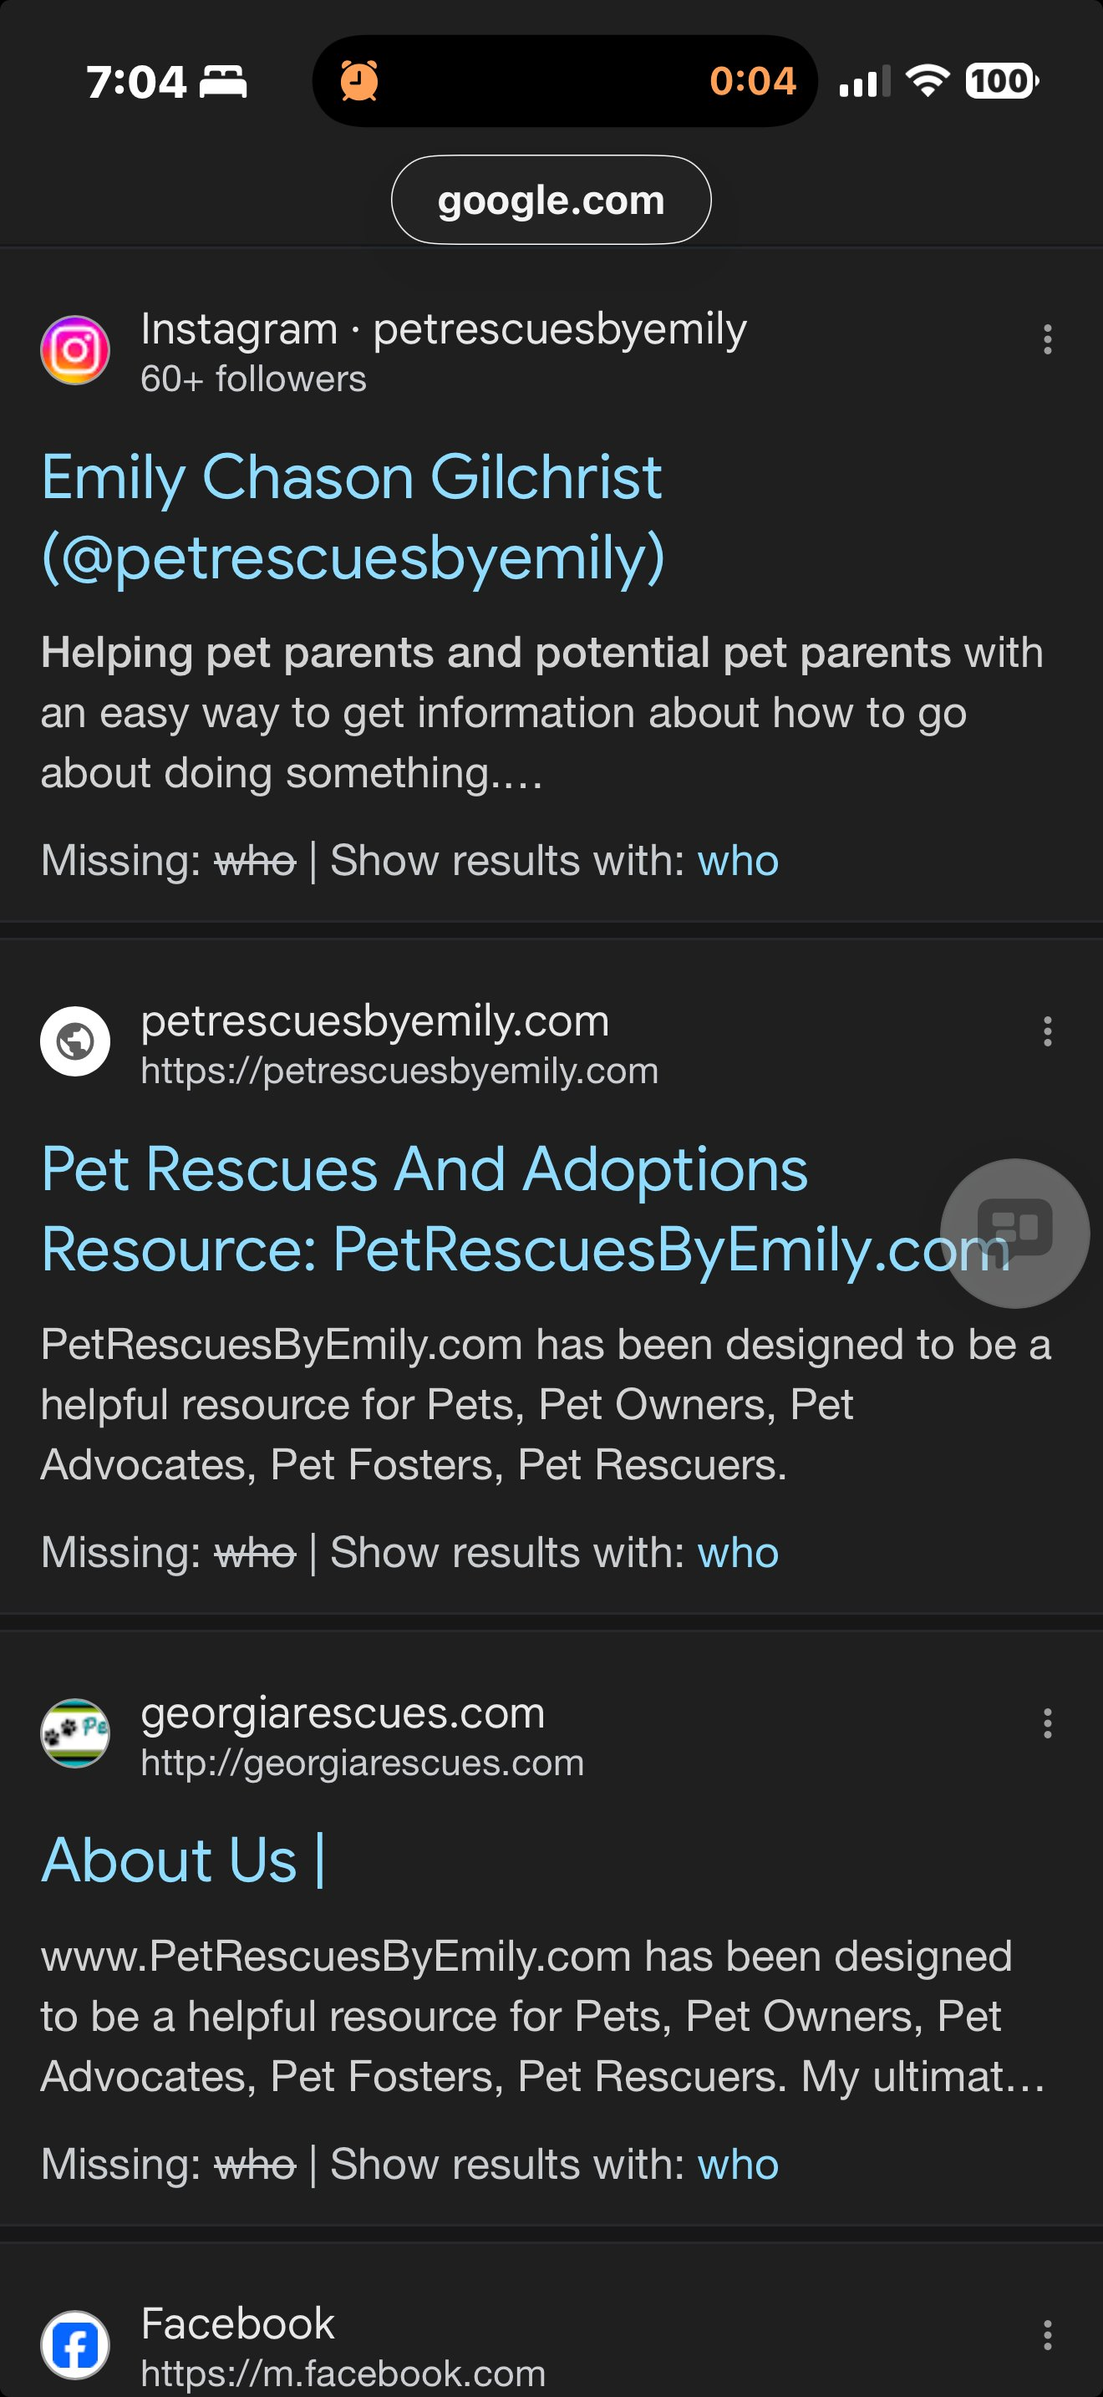
Emily's Online Identity — Brand Continuity Evidence
Google search for 'who is www.PetRescuesByEmily.com' returns Emily Chason Gilchrist's Facebook (Atlanta, GA) and Instagram (@petrescuesbyemily) as top results — confirming the domain belongs to a real, identifiable rescue advocate.
Recovering Domain: PetRescuesByEmily.com By Margaret Scott Lynch / ZebraMultimedia / MaggieTheGeek@gMail.com / Submitted 20260511 / Slide #

Slide 15
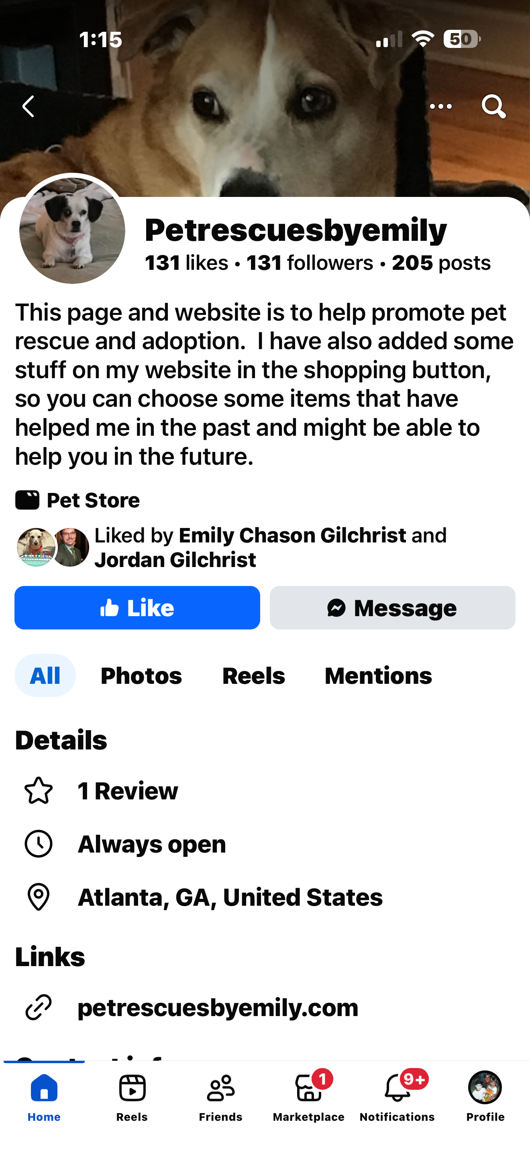
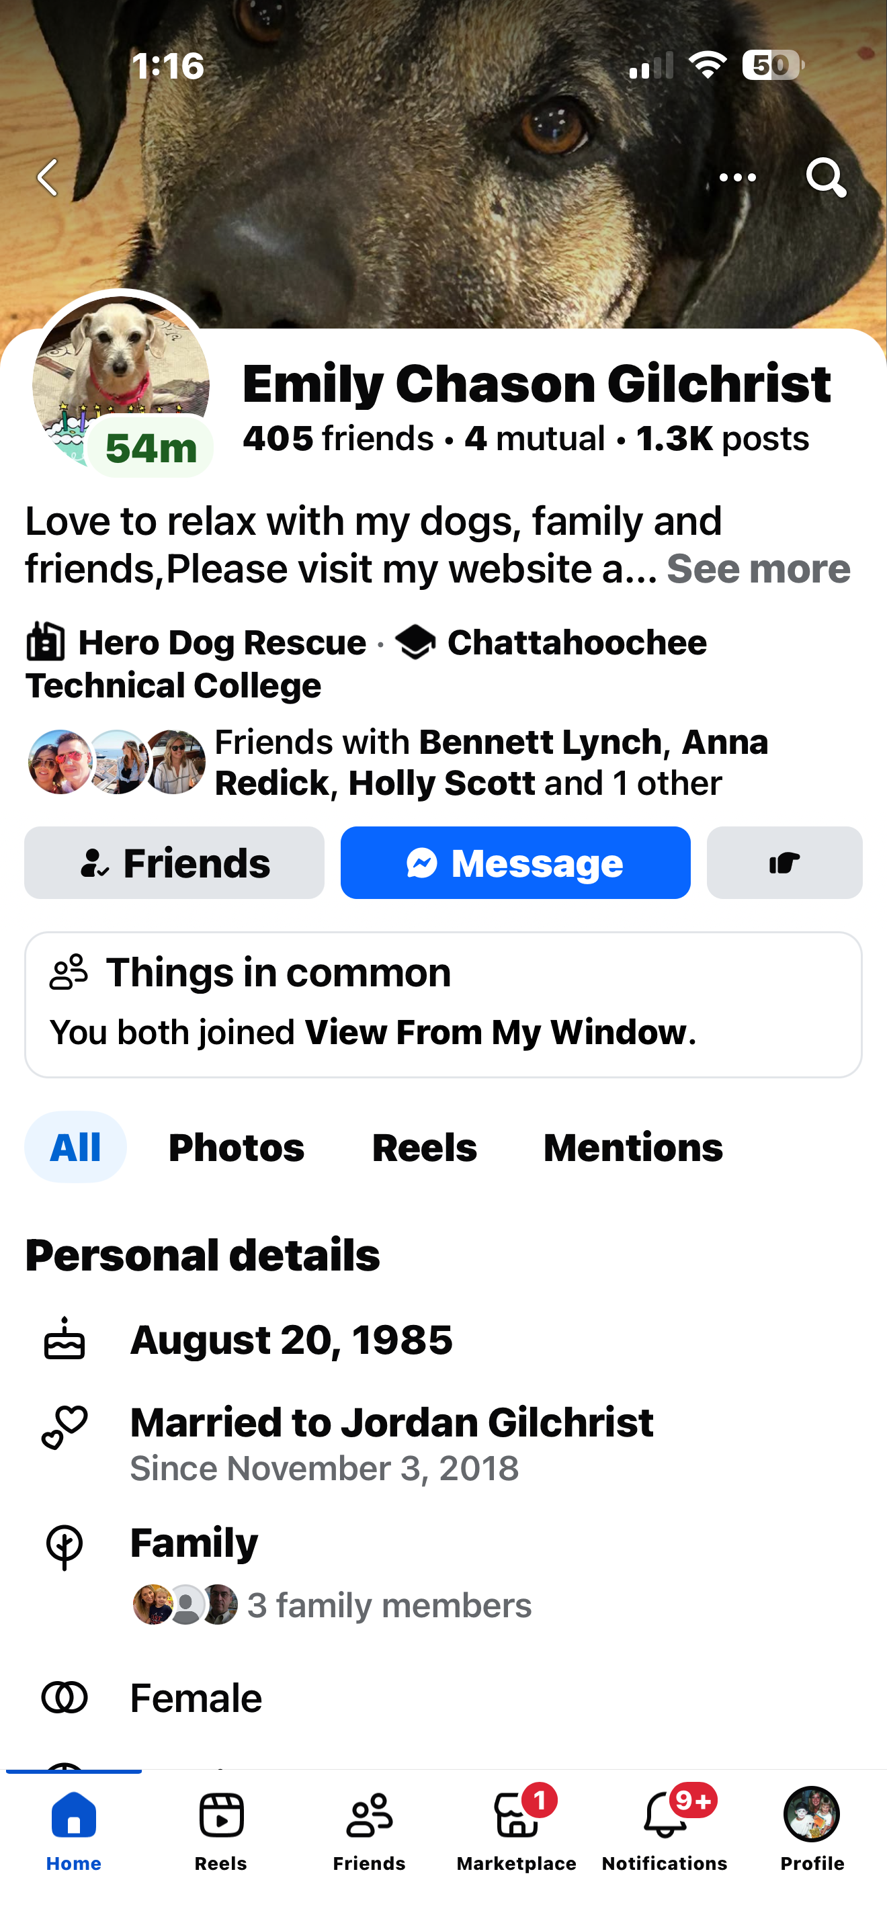
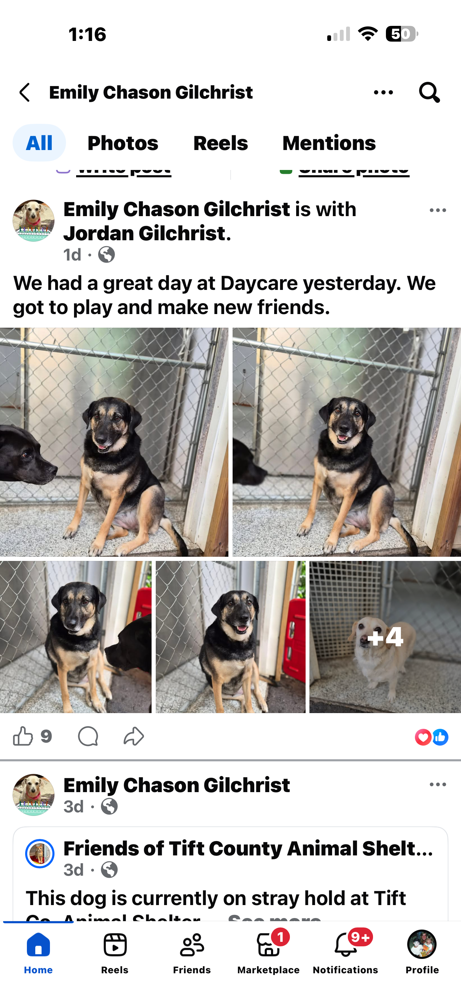
Emily's Facebook — Active Rescue Advocate, Live Website Link
NOTE: The Petrescuesbyemily Facebook brand page is being actively maintained to preserve common law trademark rights in the name — it is not abandoned. With the domain stolen, Emily has shifted active rescue posting to her personal account. Left: The brand page with petrescuesbyemily.com still listed as the website link. Center: Emily's personal profile — Hero Dog Rescue, active rescue advocate. Right: Emily posting shelter dogs needing homes just 1–3 days ago. The brand lives. The squatter holds the domain.
Recovering Domain: PetRescuesByEmily.com By Margaret Scott Lynch / ZebraMultimedia / MaggieTheGeek@gMail.com / Submitted 20260511 / Slide #

Slide 16
Theme & Source-Code Continuity
twentyten theme folder
style.css references
Source-code references to original uploads
Original navigation structure continuity
Recovering Domain: PetRescuesByEmily.com By Margaret Scott Lynch / ZebraMultimedia / MaggieTheGeek@gMail.com / Submitted 20260511 / Slide #

Slide 17
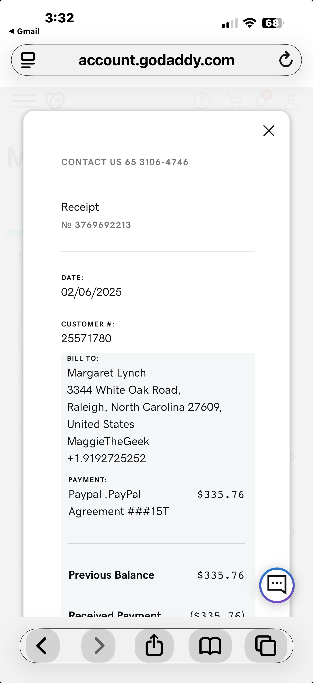
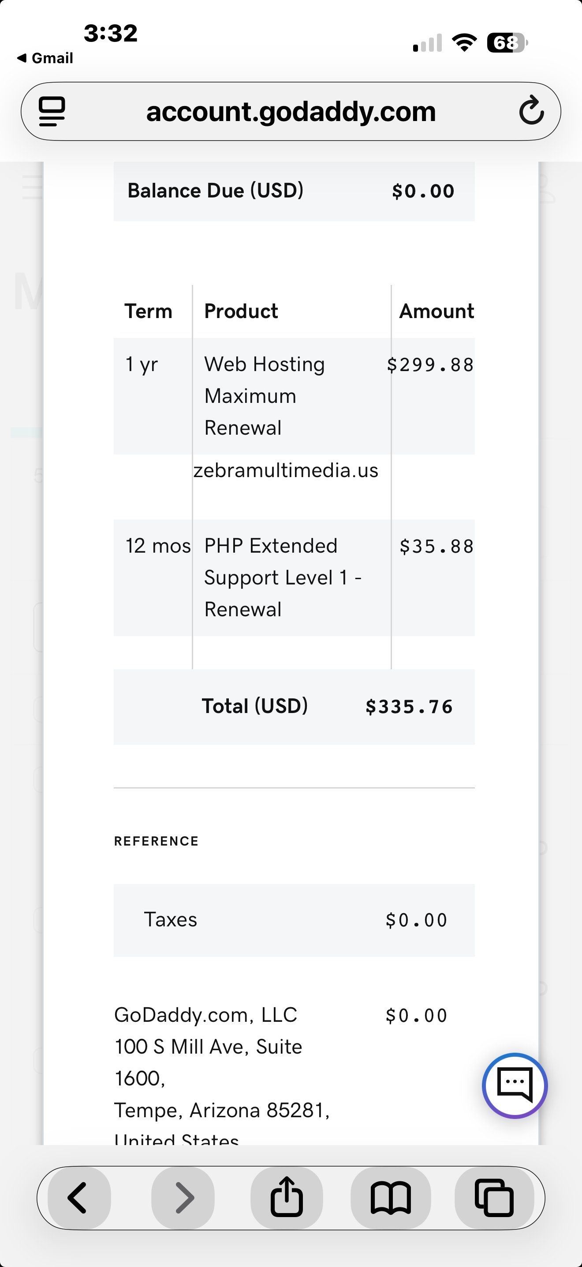
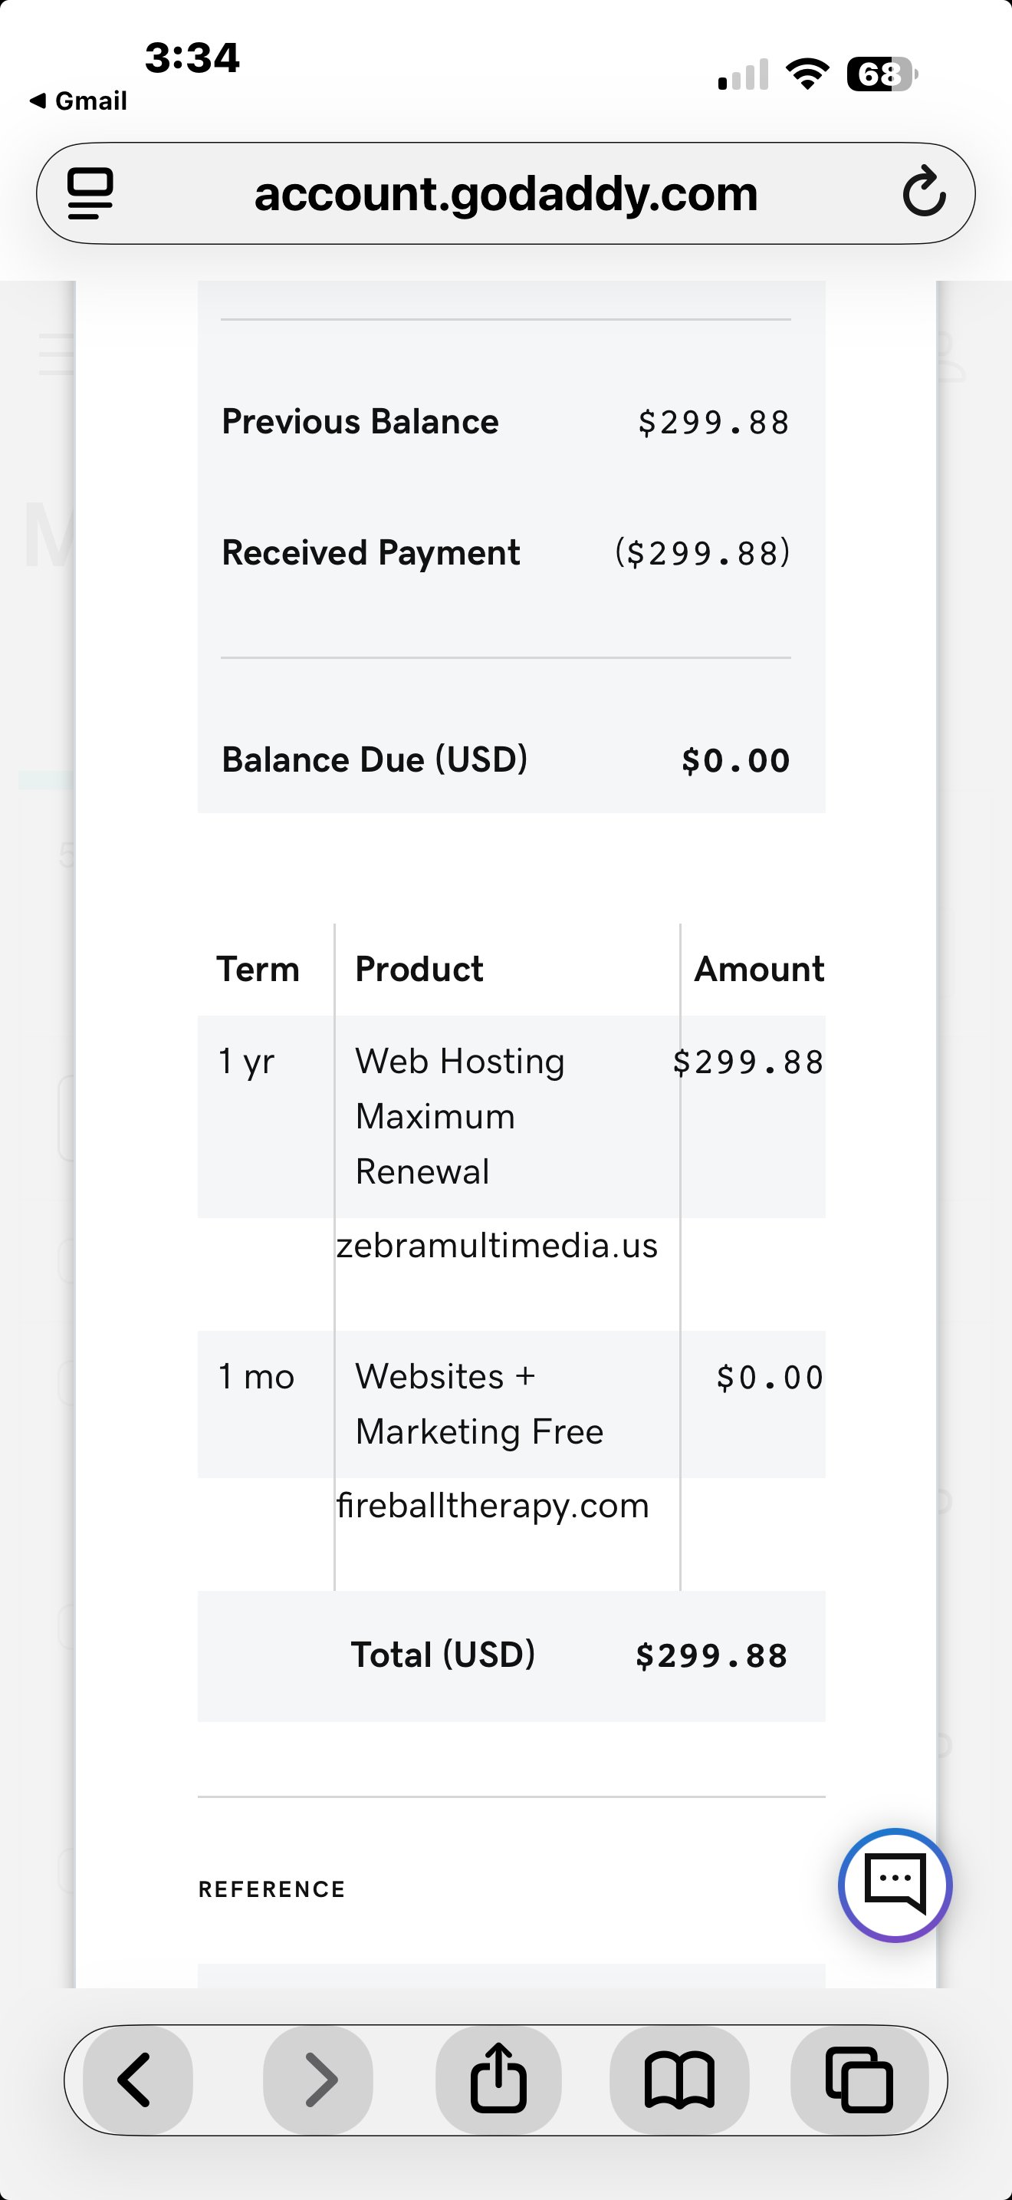
GoDaddy Customer Relationship — Active Account Documentation
GoDaddy receipts confirming Margaret Scott Lynch as an active, paying, long-tenured Super Reseller — zebramultimedia.us, fireballtherapy.com, and maggiethegeek.com all serviced through GoDaddy.
Recovering Domain: PetRescuesByEmily.com By Margaret Scott Lynch / ZebraMultimedia / MaggieTheGeek@gMail.com / Submitted 20260511 / Slide #

Slide 18
Wayback Machine Continuity
38 Wayback Machine captures preserved and documented
Archived homepage captures
Original mascot images
Matching structure and branding
Historical continuity timeline
Recovering Domain: PetRescuesByEmily.com By Margaret Scott Lynch / ZebraMultimedia / MaggieTheGeek@gMail.com / Submitted 20260511 / Slide #

Slide 19
Closing Request
My request is not based on denying my renewal mistake.
My request is based upon asking GoDaddy to consider the unique circumstances surrounding a longstanding rescue platform whose original copyrighted materials, structure and identity continue appearing under control of an unknown third party.
Thank you for your time and review.
GoDaddy Case: DCU101180266
ICANN Case: 01581431
Public Evidence: maggiethegeek.com/cyber-squatter-complaint/
Recovering Domain: PetRescuesByEmily.com By Margaret Scott Lynch / ZebraMultimedia / MaggieTheGeek@gMail.com / Submitted 20260511 / Slide #

Slide 20
Additional Personal Context
At the same time this situation has been unfolding, portions of my home have also been undergoing ongoing reorganization and preparation work, including basement and workspace-related projects connected to creating a functional ZebraMultimedia office and creative workspace.
The combination of health limitations, household disruption, technical issues and continual documentation efforts has made organizing and reviewing materials substantially more difficult than normal.
Recovering Domain: PetRescuesByEmily.com By Margaret Scott Lynch / ZebraMultimedia / MaggieTheGeek@gMail.com / Submitted 20260511 / Slide #

Slide 21
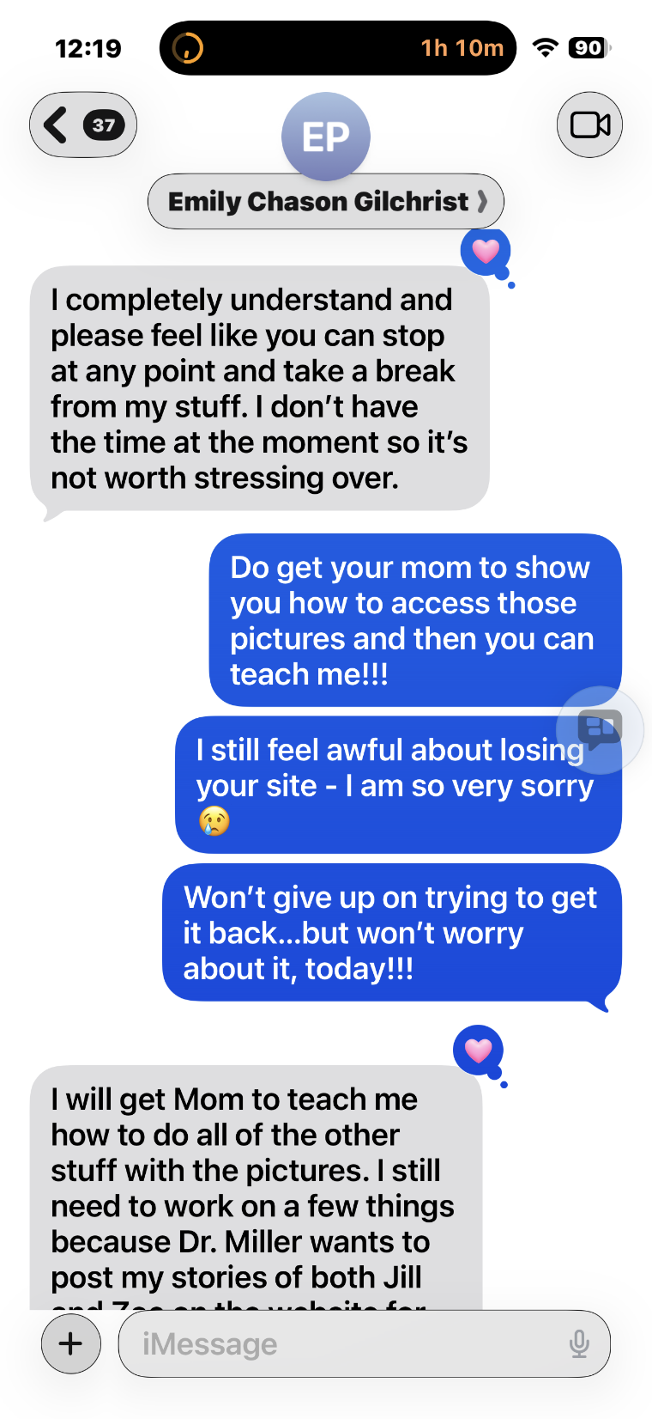
Emily's iMessage — Planned Website Updates
Recovering Domain: PetRescuesByEmily.com By Margaret Scott Lynch / ZebraMultimedia / MaggieTheGeek@gMail.com / Submitted 20260511 / Slide # 1 of 58

Slide 22
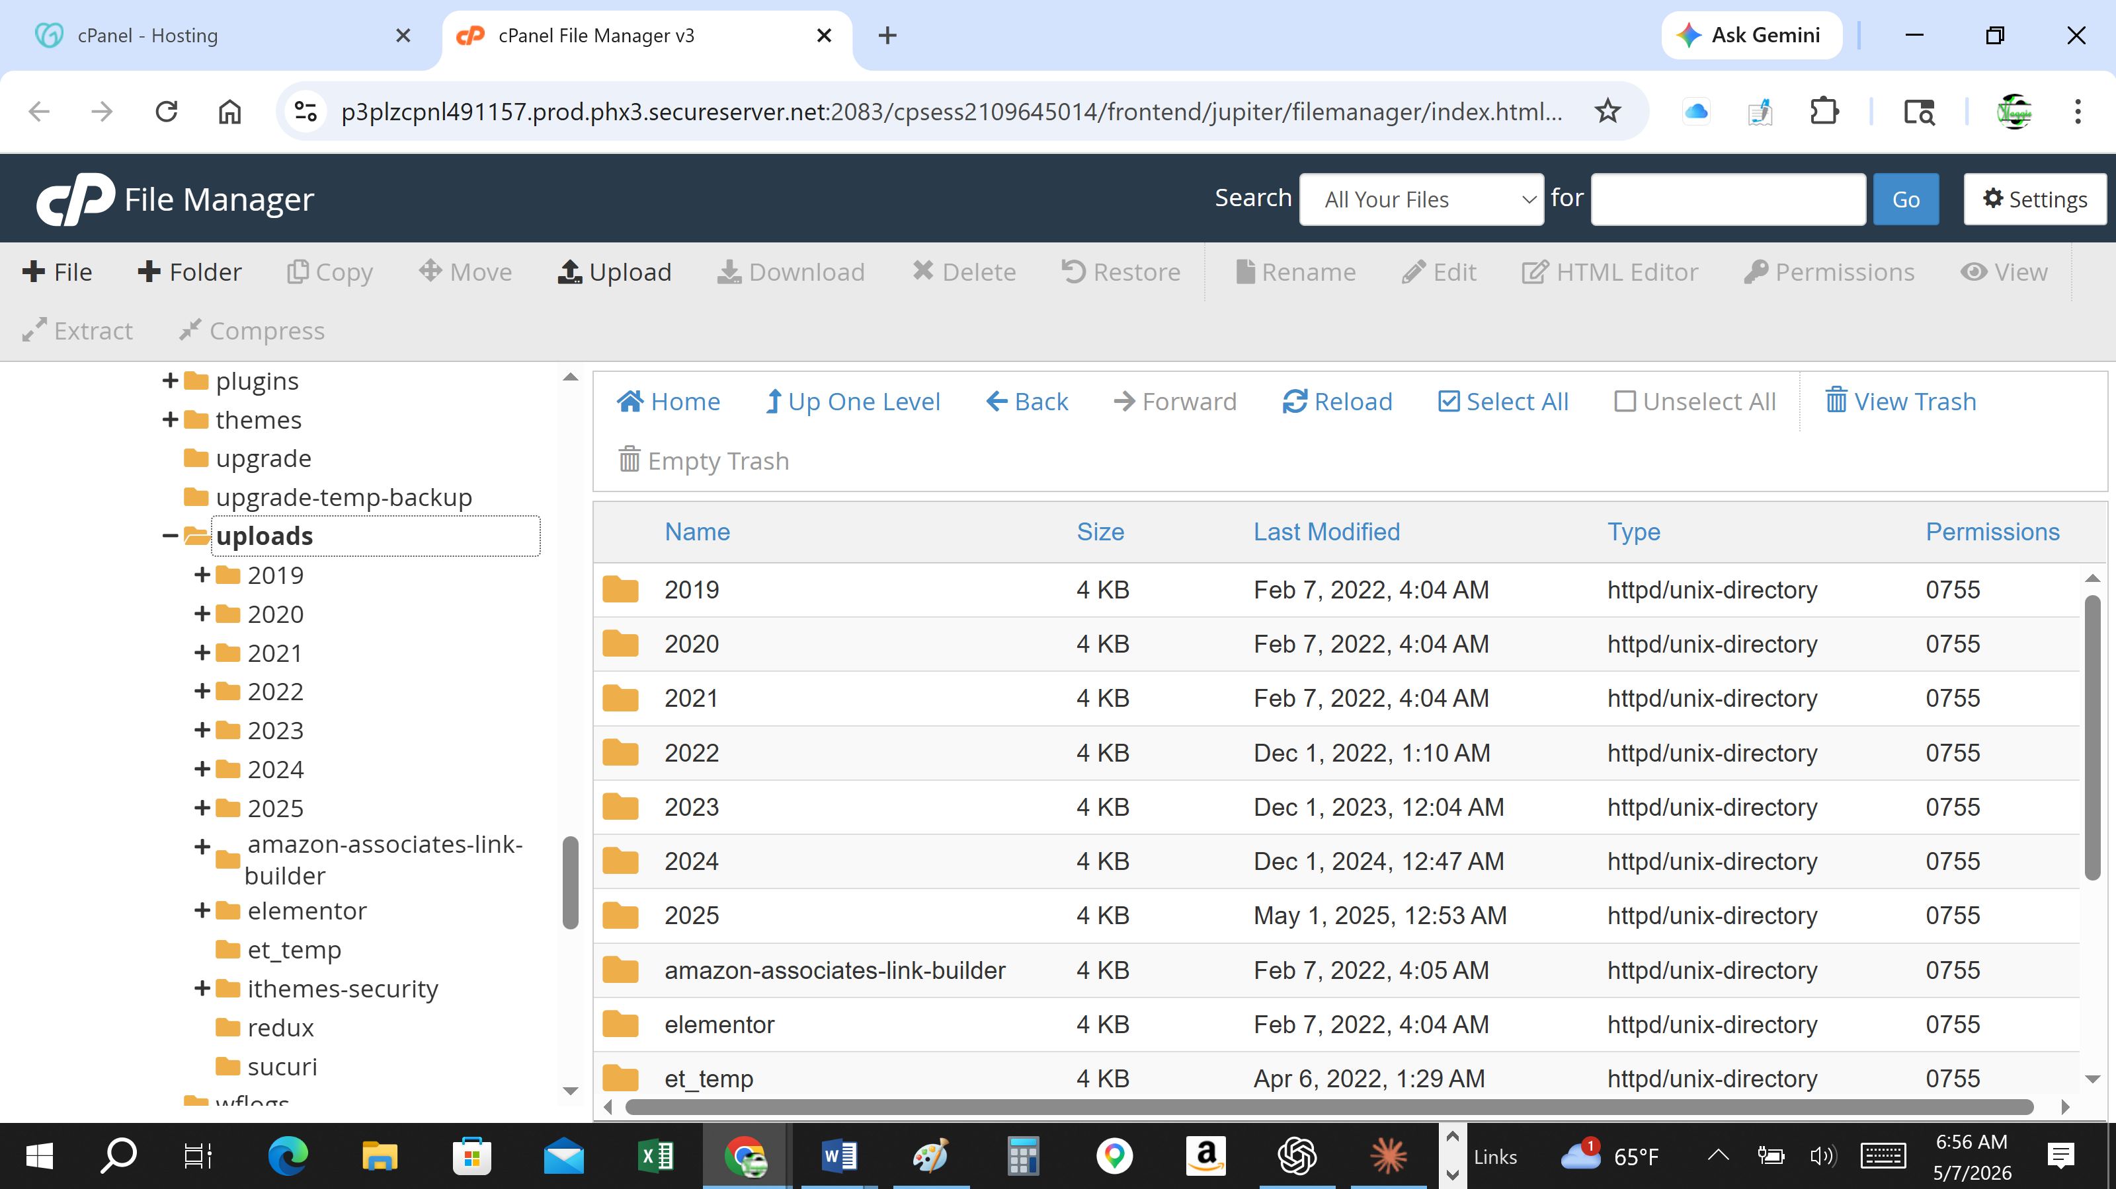
Important Context
This was not an abandoned placeholder domain during a documented medical crisis.
Recovering Domain: PetRescuesByEmily.com By Margaret Scott Lynch / ZebraMultimedia / MaggieTheGeek@gMail.com / Submitted 20260511 / Slide # 1 of 58

Slide 23
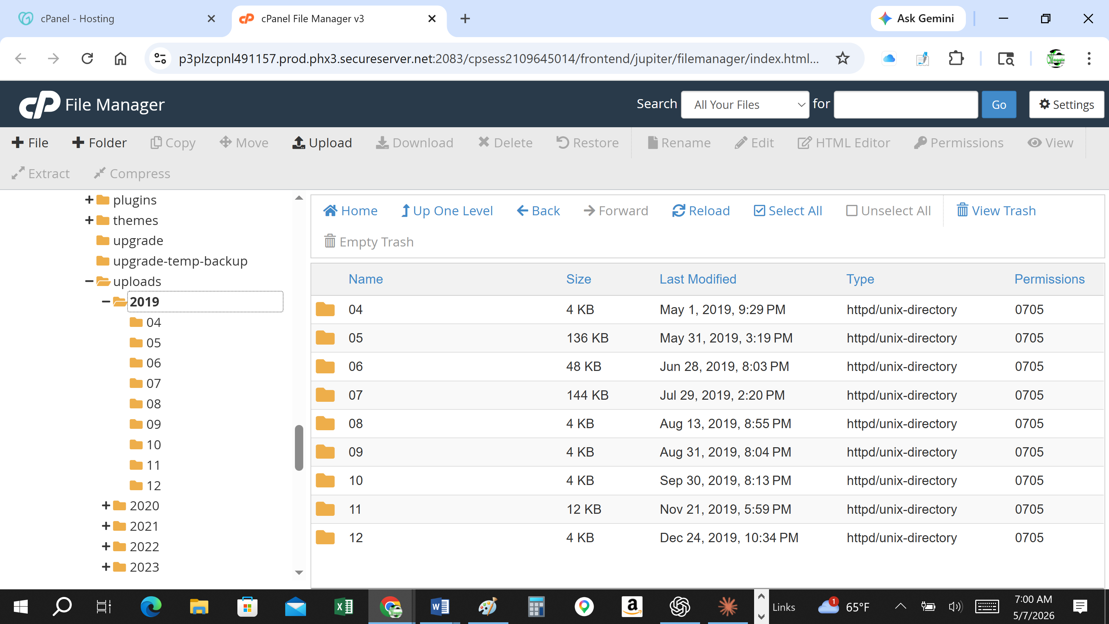
Original Website Continuity
Original branding, uploads and rescue-platform continuity.
Recovering Domain: PetRescuesByEmily.com By Margaret Scott Lynch / ZebraMultimedia / MaggieTheGeek@gMail.com / Submitted 20260511 / Slide # 1 of 58

Slide 24
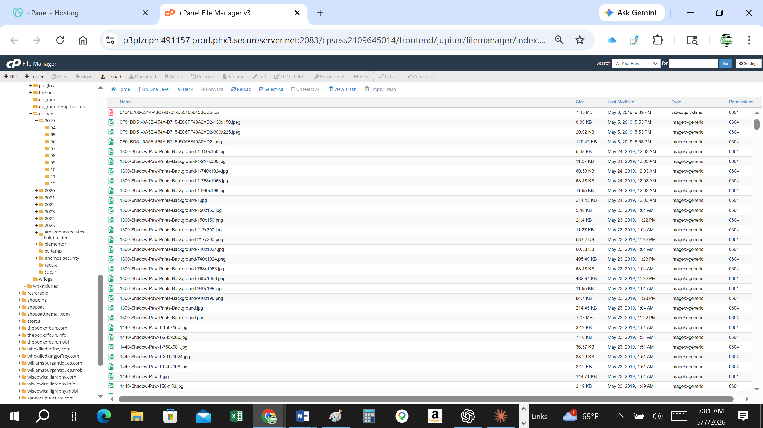
Visual Continuity Evidence
Current disputed site continues displaying recognizable structure and identity.
Recovering Domain: PetRescuesByEmily.com By Margaret Scott Lynch / ZebraMultimedia / MaggieTheGeek@gMail.com / Submitted 20260511 / Slide # 1 of 58

Slide 25
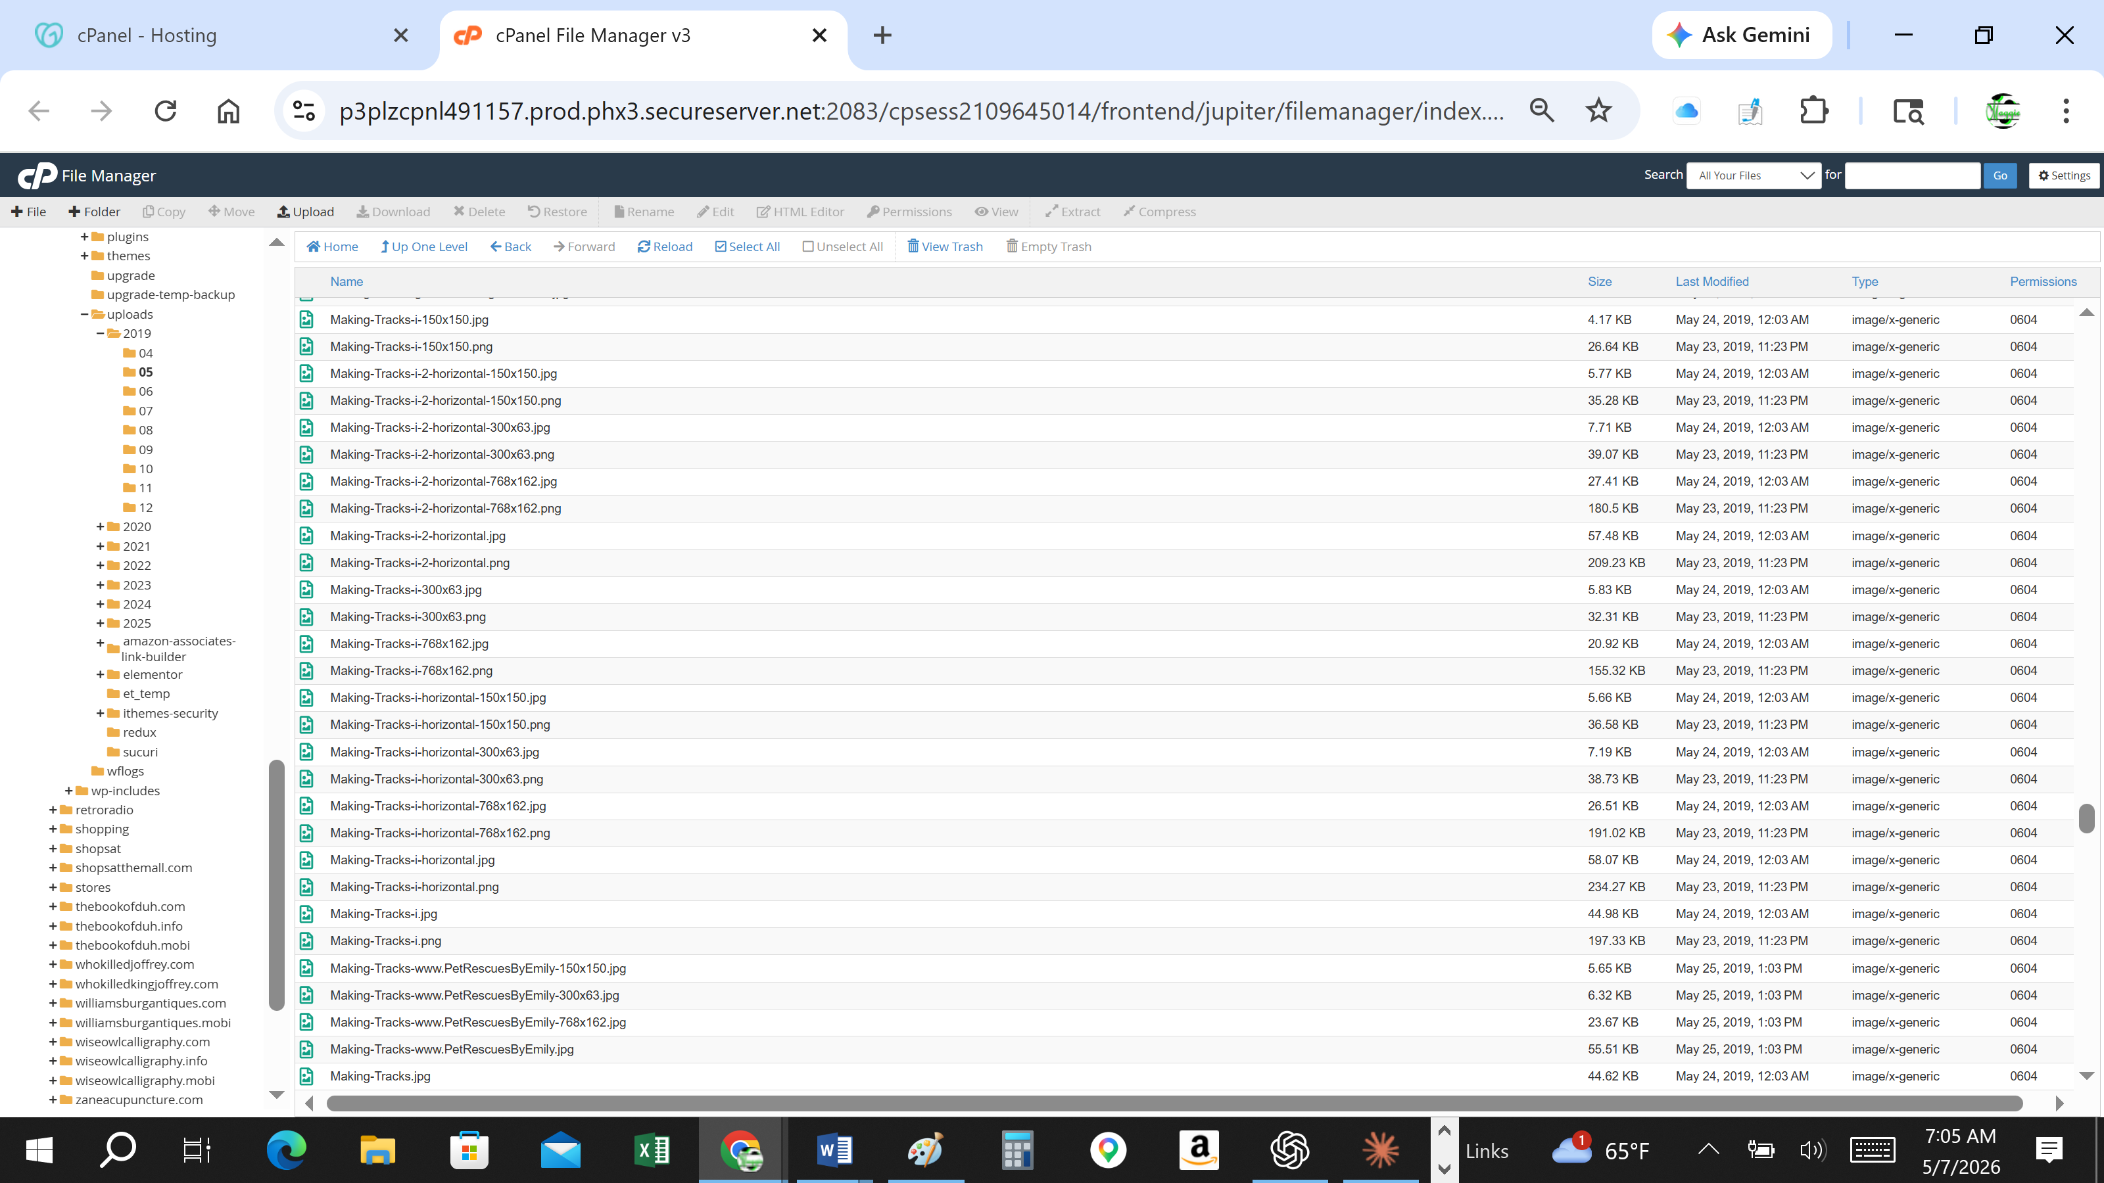
Wayback & Technical Continuity
Archived captures, WordPress continuity and technical overlap.
Recovering Domain: PetRescuesByEmily.com By Margaret Scott Lynch / ZebraMultimedia / MaggieTheGeek@gMail.com / Submitted 20260511 / Slide # 1 of 58

Slide 26
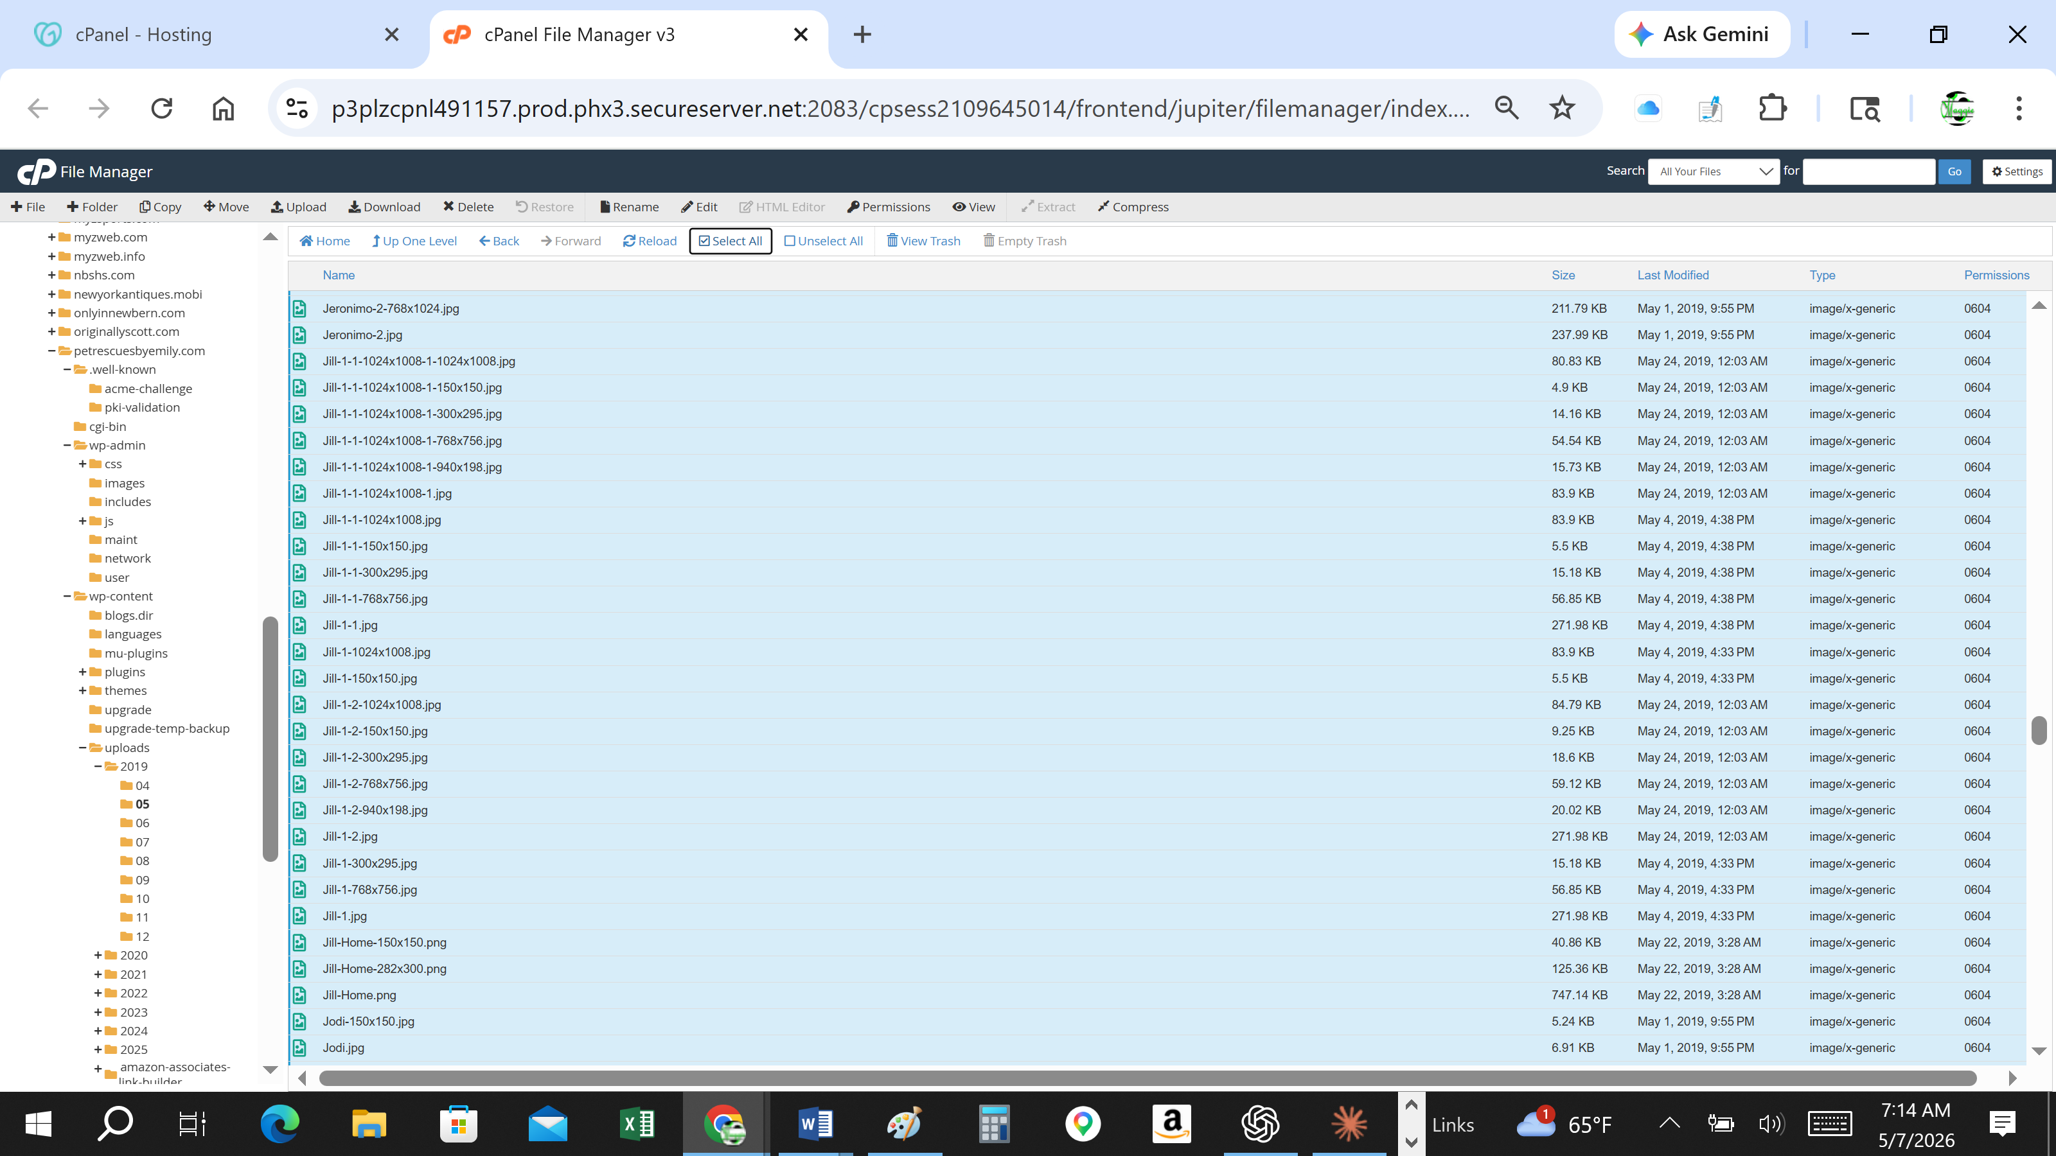
Human & Community Impact
Memorial pages, rescue stories and community outreach were interrupted.
Recovering Domain: PetRescuesByEmily.com By Margaret Scott Lynch / ZebraMultimedia / MaggieTheGeek@gMail.com / Submitted 20260511 / Slide # 1 of 58

Slide 27
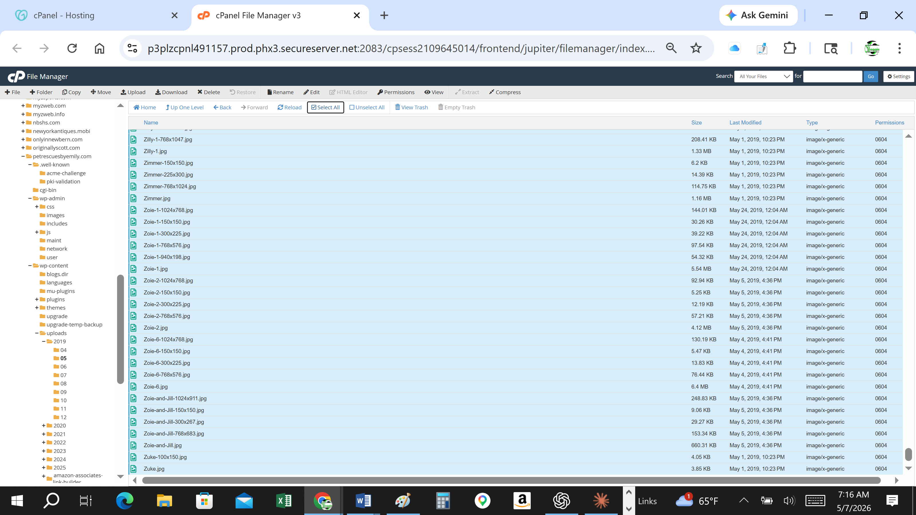
Closing Request
Request for compassionate executive review and restoration assistance.
Recovering Domain: PetRescuesByEmily.com By Margaret Scott Lynch / ZebraMultimedia / MaggieTheGeek@gMail.com / Submitted 20260511 / Slide # 1 of 58

Slide 28
PetRescuesByEmily.com
Private Review Archive for GoDaddy Office of the CEO
Prepared by Margaret Scott Lynch
ZebraMultimedia / MaggieTheGeek
PetRescuesByEmily.com • Private Review Archive
Recovering Domain: PetRescuesByEmily.com By Margaret Scott Lynch / ZebraMultimedia / MaggieTheGeek@gMail.com / Submitted 20260511 / Slide # 1 of 58

Slide 29
Purpose of This Archive
• Consolidated private review archive
• Visual continuity evidence
• Original WordPress hosting continuity
• Source-code continuity observations
• Wayback Machine continuity
• Rescue platform history and context
PetRescuesByEmily.com • Private Review Archive
Recovering Domain: PetRescuesByEmily.com By Margaret Scott Lynch / ZebraMultimedia / MaggieTheGeek@gMail.com / Submitted 20260511 / Slide # 1 of 58

Slide 30
Important Context
• The first and biggest mistake was the missed renewal during a documented health crisis
• This was not an abandoned placeholder domain
• The website represented years of active rescue advocacy and original content
• The current disputed site continues displaying substantial continuity with the original platform
PetRescuesByEmily.com • Private Review Archive
Recovering Domain: PetRescuesByEmily.com By Margaret Scott Lynch / ZebraMultimedia / MaggieTheGeek@gMail.com / Submitted 20260511 / Slide # 1 of 58

Slide 31
Visual Evidence Overview
This section is intended to visually demonstrate continuity between:
• Original 2019 hosting environment
• Original uploads and filenames
• Original mascot images
• Original theme structure
• Current disputed source-code references
• Archived Wayback Machine captures
PetRescuesByEmily.com • Private Review Archive
Recovering Domain: PetRescuesByEmily.com By Margaret Scott Lynch / ZebraMultimedia / MaggieTheGeek@gMail.com / Submitted 20260511 / Slide # 1 of 58

Slide 32
Original Upload Continuity — Representative Screenshots
Representative screenshots from the preserved forensic evidence file.
PetRescuesByEmily.com • Supporting evidence excerpts
Recovering Domain: PetRescuesByEmily.com By Margaret Scott Lynch / ZebraMultimedia / MaggieTheGeek@gMail.com / Submitted 20260511 / Slide # 1 of 58

Slide 33
Original Upload Continuity
My File Manager Screenshots
• /wp-content/uploads/2019/04
• /wp-content/uploads/2019/05
• Jill and Zoie image continuity
• Making-Tracks-www.PetRescuesByEmily.jpg
PetRescuesByEmily.com • Private Review Archive
Recovering Domain: PetRescuesByEmily.com By Margaret Scott Lynch / ZebraMultimedia / MaggieTheGeek@gMail.com / Submitted 20260511 / Slide # 1 of 58

Slide 34
My File Manager Screenshots of WordPress Hosting
• twentyten theme folder
• style.css references
• source-code references to original uploads
• original navigation continuity
PetRescuesByEmily.com • Private Review Archive
Recovering Domain: PetRescuesByEmily.com By Margaret Scott Lynch / ZebraMultimedia / MaggieTheGeek@gMail.com / Submitted 20260511 / Slide # 1 of 58

Slide 35
Theme & Source-Code Continuity — My File Manager Screenshots
Representative screenshots showing technical/visual continuity.
PetRescuesByEmily.com • Supporting evidence excerpts
Recovering Domain: PetRescuesByEmily.com By Margaret Scott Lynch / ZebraMultimedia / MaggieTheGeek@gMail.com / Submitted 20260511 / Slide # 1 of 58

Slide 36
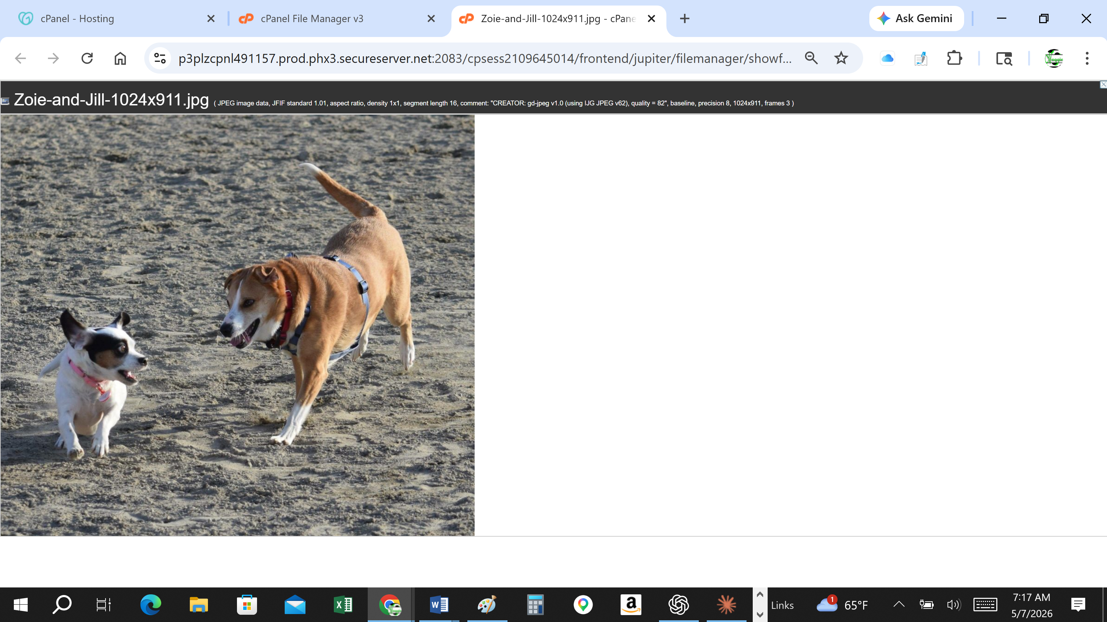
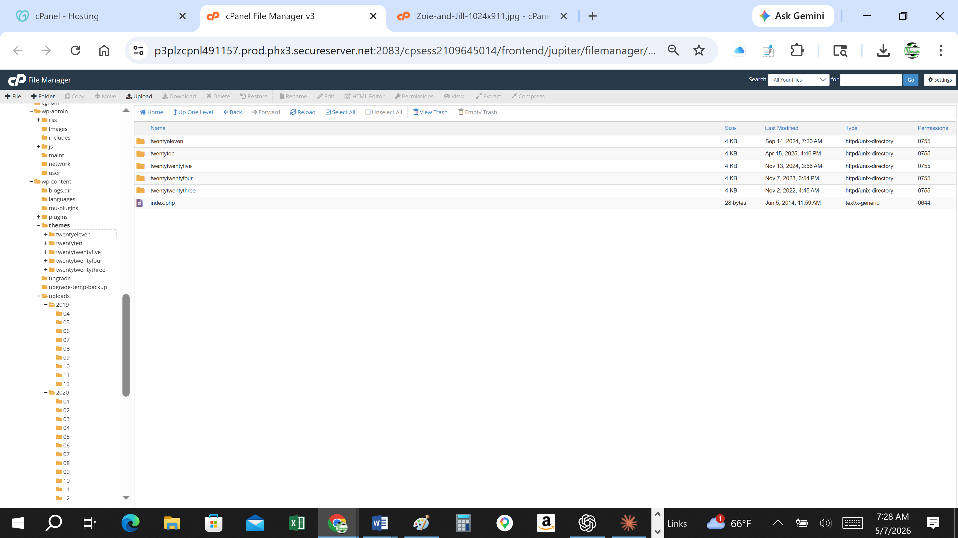
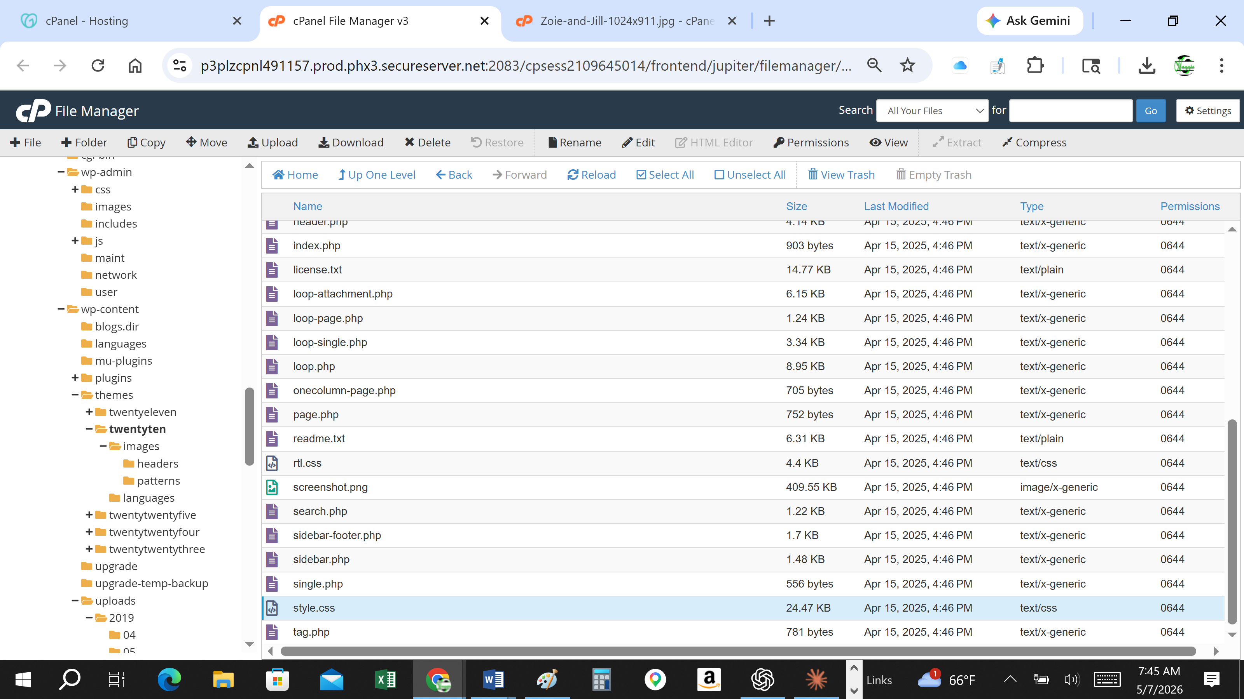
Wayback Machine Continuity — Representative Screenshots
Representative screenshots showing archived continuity and public-facing evidence.
PetRescuesByEmily.com • Supporting evidence excerpts
Recovering Domain: PetRescuesByEmily.com By Margaret Scott Lynch / ZebraMultimedia / MaggieTheGeek@gMail.com / Submitted 20260511 / Slide # 1 of 58

Slide 37
Wayback Machine Continuity
Insert screenshots here:
• Archived homepage captures
• Original mascot images
• Matching structure and branding
• Historical continuity timeline
PetRescuesByEmily.com • Private Review Archive
Recovering Domain: PetRescuesByEmily.com By Margaret Scott Lynch / ZebraMultimedia / MaggieTheGeek@gMail.com / Submitted 20260511 / Slide # 1 of 58

Slide 38
Closing Request
My request is not based on denying my renewal mistake. It is based on doing what is right and my validating GoDaddy’s Terms of Service on the purchase to Domain rights via expired domain auction.
My request is based upon asking GoDaddy to consider the unique circumstances surrounding a longstanding rescue platform whose original copyrighted materials, structure and identity continue appearing under control of an unknown third party who has deliberately stolen our Intellectual Property, Our Source Code including Copyright 2019, Our Mission Statement word for word, our Front Page Hyperlinks now completely dead and cycle back to our our original home page text.
Thank you for your time and review.
PetRescuesByEmily.com • Private Review Archive
Recovering Domain: PetRescuesByEmily.com By Margaret Scott Lynch / ZebraMultimedia / MaggieTheGeek@gMail.com / Submitted 20260511 / Slide # 1 of 58

Slide 39

Tangible Marketing
Alexa's response to your "Tangible Marketing Blurb for Emily's Business Cards" request **Physical Brand Presence Through Business Cards** Emily's custom business cards created what's called "tangible brand recognition" - a physical, real-world presence that extended far beyond her digital footprint! These weren't just contact cards; they were powerful brand ambassadors that people could hold, share, and remember. When Emily handed out those beautifully coordinated cards at the grocery store and veterinary office, she was building what marketers call "offline brand equity." Each card created a lasting impression and established her Pet Rescues mission as a legitimate, trustworthy organization in her community. This physical branding strategy proved that Emily's work wasn't just an online hobby - it was a serious, professional commitment to animal welfare that people could literally hold in their hands! The cards transformed digital connections into meaningful, personal relationships that helped over 450 animals find their forever homes. **The power of tangible marketing in a digital world - that's what made Emily's mission unforgettable!** Sent from Alexa ©2026 Amazon.com, Inc. or its affiliates. Amazon and all related marks are trademarks of Amazon.com, Inc. or its affiliates, Amazon.com, Inc. 410 Terry Avenue N., Seattle, WA 98109.
Recovering Domain: PetRescuesByEmily.com By Margaret Scott Lynch / ZebraMultimedia / MaggieTheGeek@gMail.com / Submitted 20260511 / Slide #

Slide 40
Snippet of Photos and Screenshots regarding conversations and proof.
Please note:
This is only a snippet of Proof, Photos and Screenshots but did not want to overwhelm the reviewer. If you need more, please let me know.
Margaret Scott Lynch
Recovering Domain: PetRescuesByEmily.com By Margaret Scott Lynch / ZebraMultimedia / MaggieTheGeek@gMail.com / Submitted 20260511 / Slide # 1 of 58

Slide 41
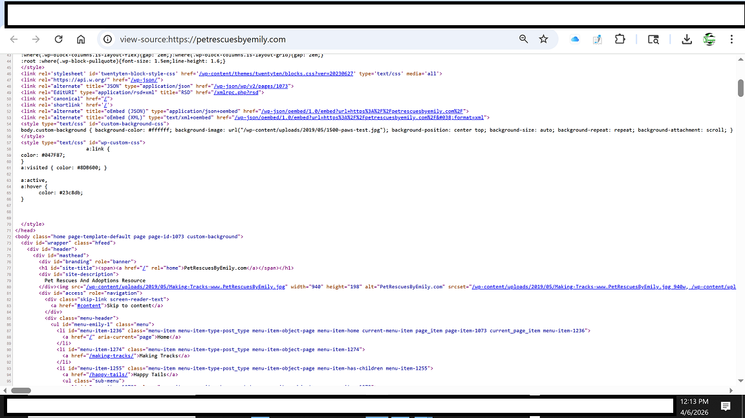
Legacy Website Source Code — view-source:petrescuesbyemily.com
Recovering Domain: PetRescuesByEmily.com By Margaret Scott Lynch / ZebraMultimedia / MaggieTheGeek@gMail.com / Submitted 20260511 / Slide # 1 of 58

Slide 42
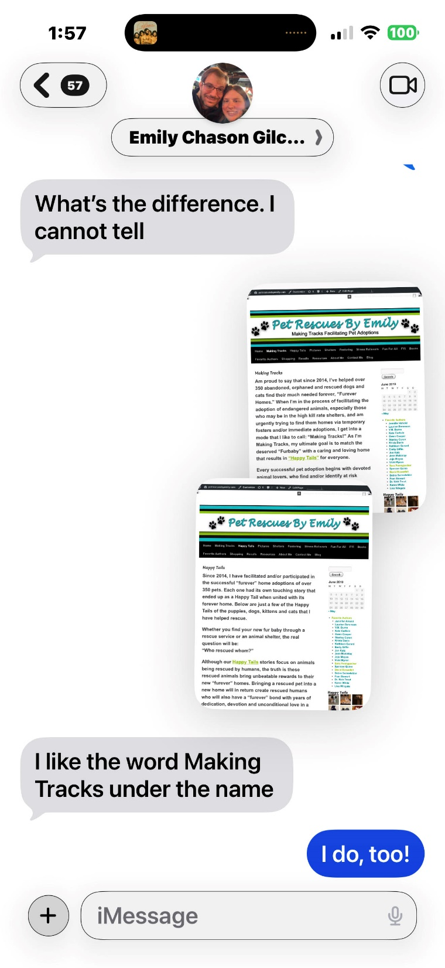
2019 iMessage — Website Name Discussion with Emily
Recovering Domain: PetRescuesByEmily.com By Margaret Scott Lynch / ZebraMultimedia / MaggieTheGeek@gMail.com / Submitted 20260511 / Slide # 1 of 58

Slide 43
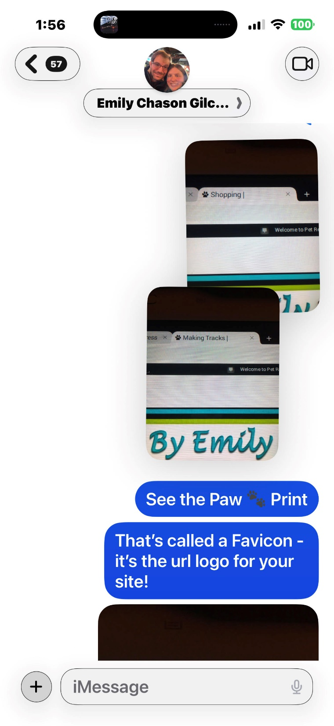
2019 iMessage — Paw Print Favicon Recognition
Recovering Domain: PetRescuesByEmily.com By Margaret Scott Lynch / ZebraMultimedia / MaggieTheGeek@gMail.com / Submitted 20260511 / Slide # 1 of 58

Slide 44
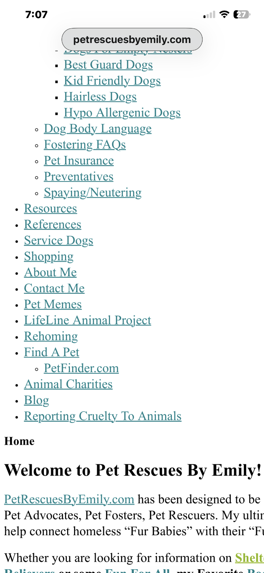
Current Website Navigation — Original Menu Structure
Recovering Domain: PetRescuesByEmily.com By Margaret Scott Lynch / ZebraMultimedia / MaggieTheGeek@gMail.com / Submitted 20260511 / Slide # 1 of 58

Slide 45
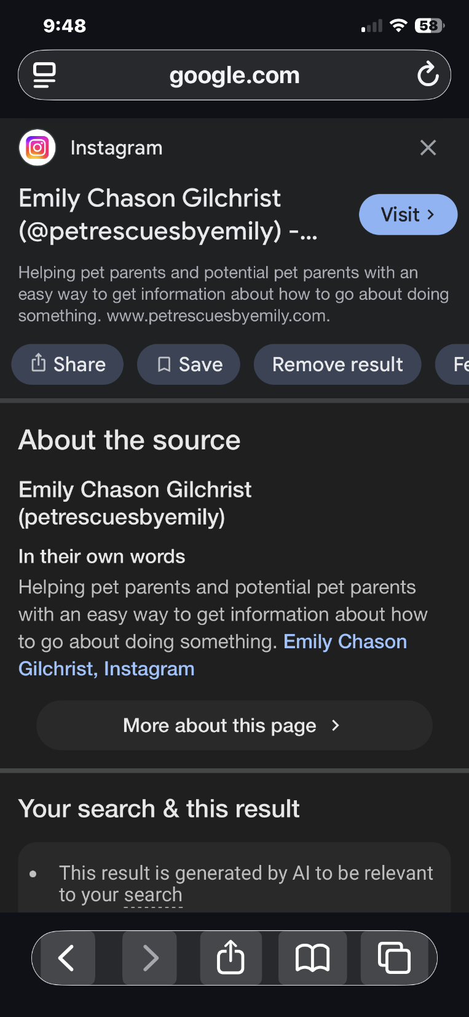
Google Search — Emily's Instagram Identity Confirmed
Recovering Domain: PetRescuesByEmily.com By Margaret Scott Lynch / ZebraMultimedia / MaggieTheGeek@gMail.com / Submitted 20260511 / Slide # 1 of 58

Slide 46

Google Search — Emily Chason Gilchrist Brand Identity
Recovering Domain: PetRescuesByEmily.com By Margaret Scott Lynch / ZebraMultimedia / MaggieTheGeek@gMail.com / Submitted 20260511 / Slide # 1 of 58

Slide 47
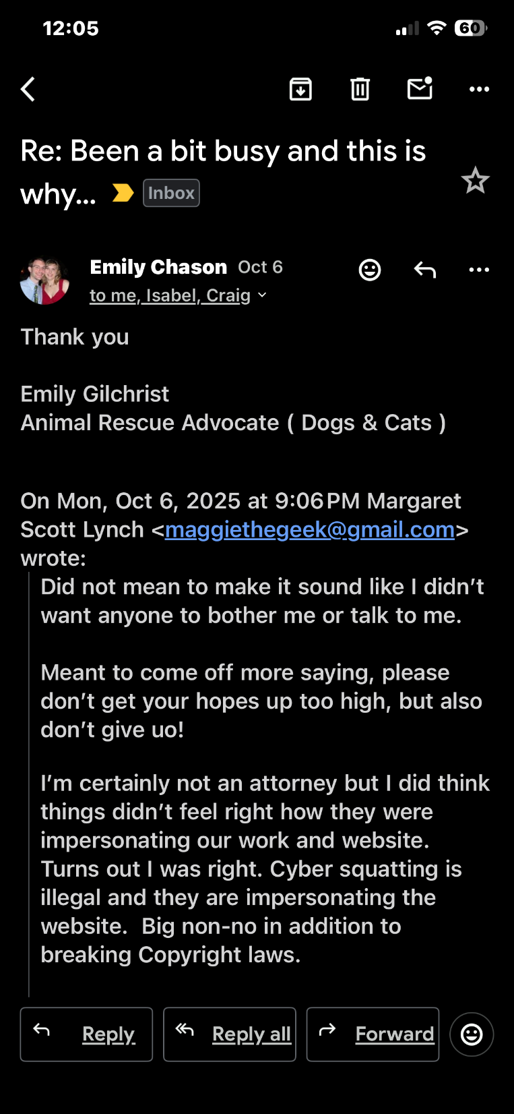
Emily's Email — October 2025 Cybersquatting Acknowledgment
Recovering Domain: PetRescuesByEmily.com By Margaret Scott Lynch / ZebraMultimedia / MaggieTheGeek@gMail.com / Submitted 20260511 / Slide # 1 of 58

Slide 48
Emily's Email — Continued Correspondence
Recovering Domain: PetRescuesByEmily.com By Margaret Scott Lynch / ZebraMultimedia / MaggieTheGeek@gMail.com / Submitted 20260511 / Slide # 1 of 58

Slide 49
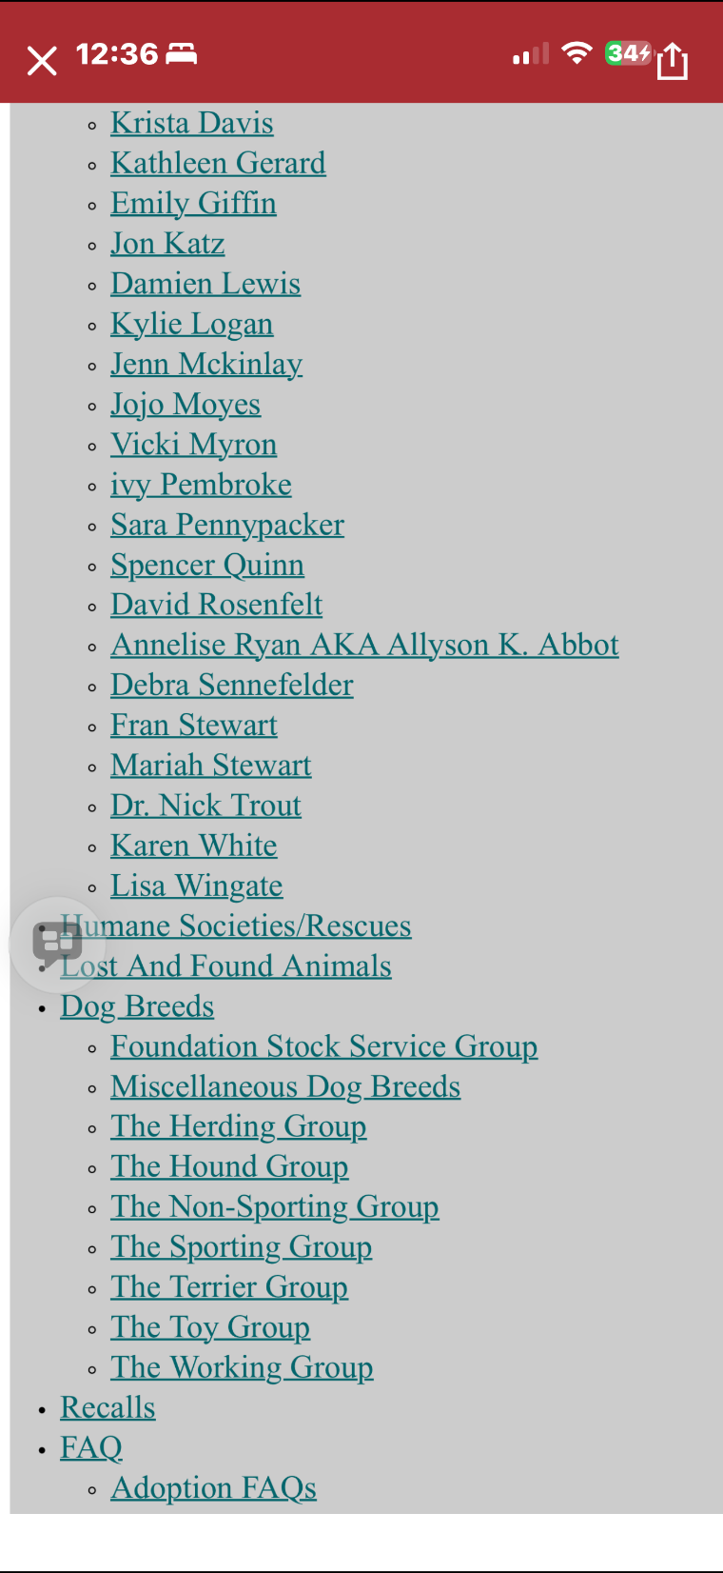
Current Website Navigation — Full Original Menu
Recovering Domain: PetRescuesByEmily.com By Margaret Scott Lynch / ZebraMultimedia / MaggieTheGeek@gMail.com / Submitted 20260511 / Slide # 1 of 58

Slide 50
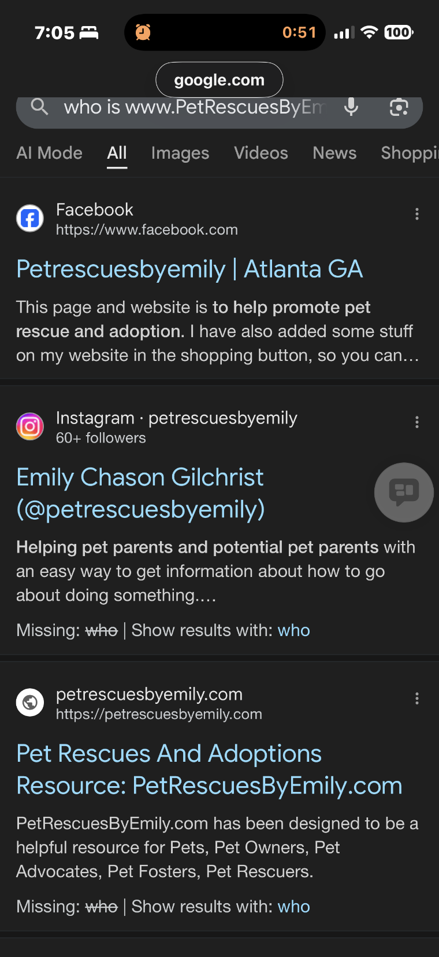
Google Search Results — PetRescuesByEmily.com Brand
Recovering Domain: PetRescuesByEmily.com By Margaret Scott Lynch / ZebraMultimedia / MaggieTheGeek@gMail.com / Submitted 20260511 / Slide # 1 of 58

Slide 51
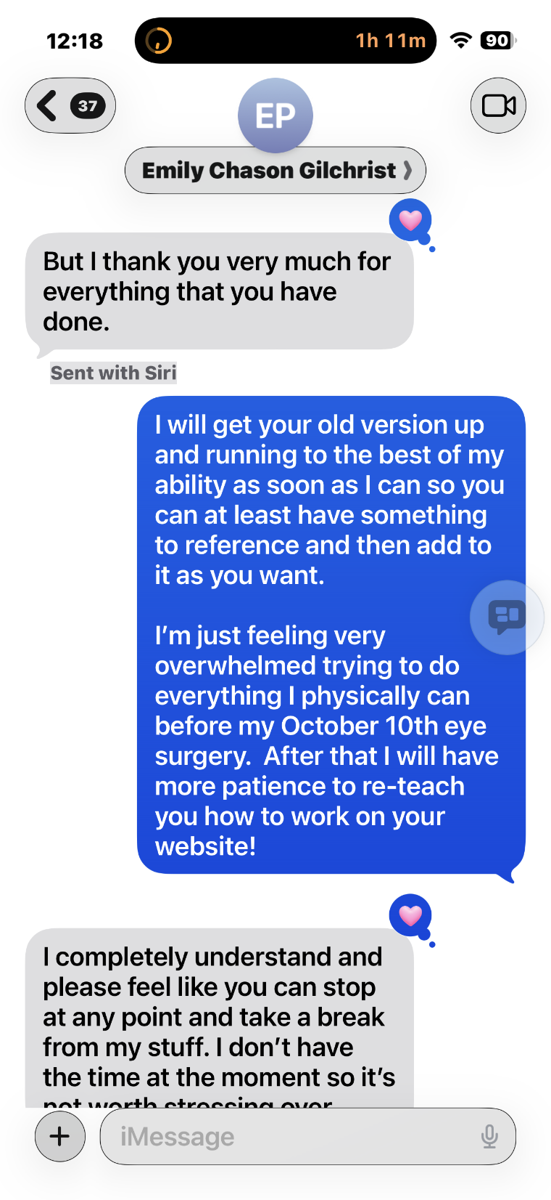
iMessage — Health Crisis Context, October 2025
Recovering Domain: PetRescuesByEmily.com By Margaret Scott Lynch / ZebraMultimedia / MaggieTheGeek@gMail.com / Submitted 20260511 / Slide # 1 of 58

Slide 52
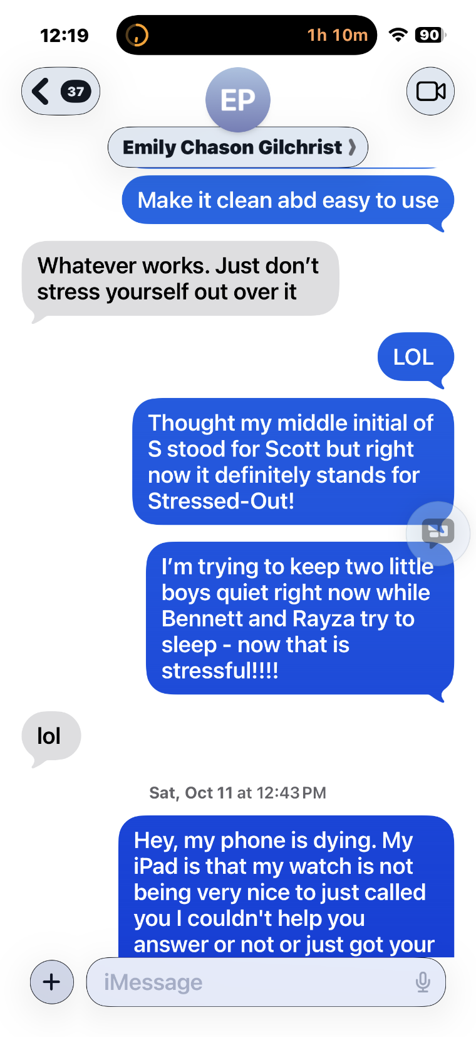
iMessage — Website Direction and Design Discussion
Recovering Domain: PetRescuesByEmily.com By Margaret Scott Lynch / ZebraMultimedia / MaggieTheGeek@gMail.com / Submitted 20260511 / Slide # 1 of 58

Slide 53
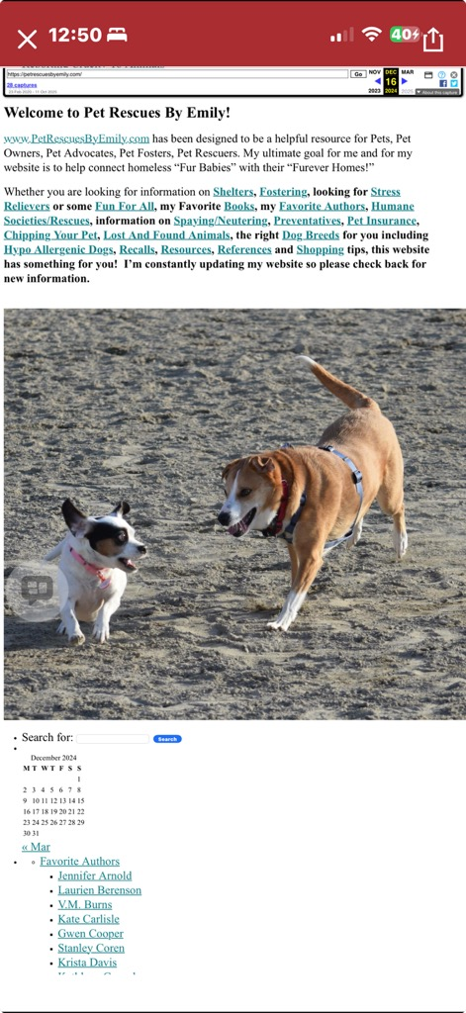
iMessage — Emily's Planned Website Updates
Recovering Domain: PetRescuesByEmily.com By Margaret Scott Lynch / ZebraMultimedia / MaggieTheGeek@gMail.com / Submitted 20260511 / Slide # 1 of 58

Slide 54
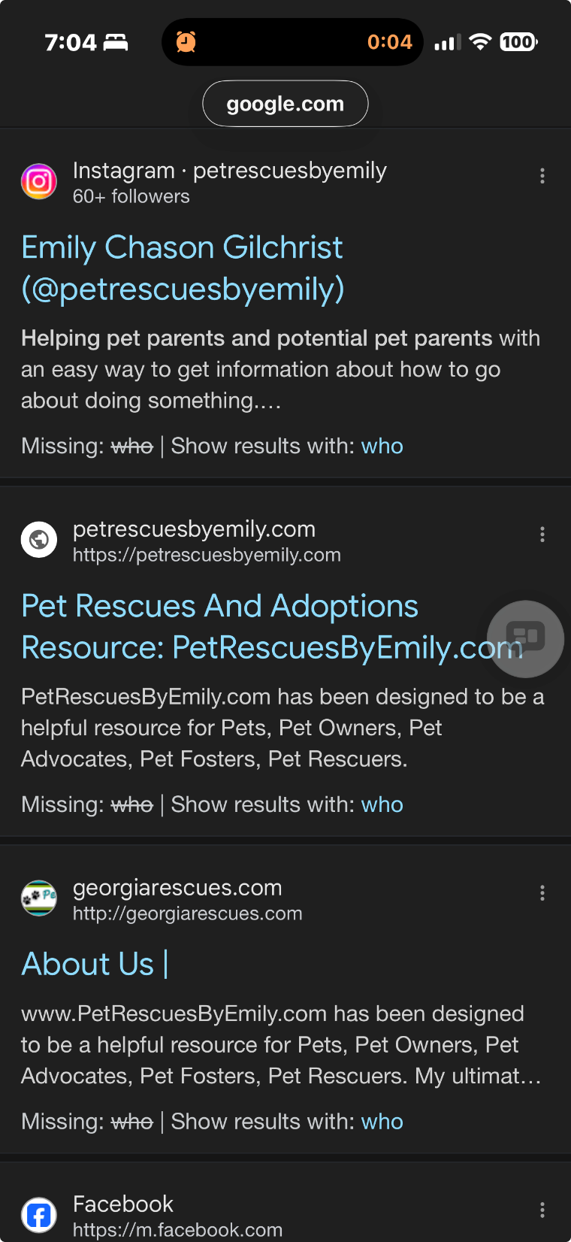
Google Search — Emily Chason Gilchrist Confirmed
Recovering Domain: PetRescuesByEmily.com By Margaret Scott Lynch / ZebraMultimedia / MaggieTheGeek@gMail.com / Submitted 20260511 / Slide # 1 of 58

Slide 55
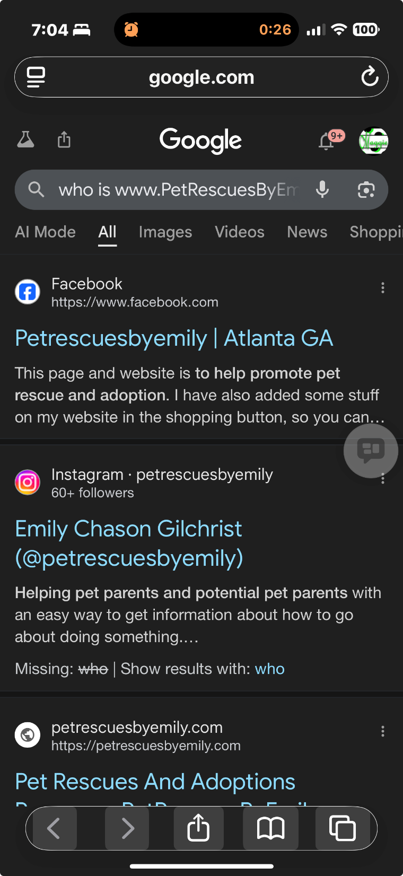
iMessage — Overwhelmed, Upcoming Eye Surgery Context
Recovering Domain: PetRescuesByEmily.com By Margaret Scott Lynch / ZebraMultimedia / MaggieTheGeek@gMail.com / Submitted 20260511 / Slide # 1 of 58

Slide 56
Wayback Machine — Original Site, December 2024 Archive
Recovering Domain: PetRescuesByEmily.com By Margaret Scott Lynch / ZebraMultimedia / MaggieTheGeek@gMail.com / Submitted 20260511 / Slide # 1 of 58

Slide 57
Interruption Of Legacy And Posthumous Online Grieving
One aspect of this situation that has been unexpectedly painful involves something Alexa and I ultimately described as a form of “digital memorial denial” connected to posthumous data and memory preservation.
PetRescuesByEmily.com was never merely a domain name or generic website. It was a living rescue platform tied to real animals, real families and years of emotionally significant community history.
After Emily lost both Jill and Zoie in early 2025, we never had the opportunity to properly create and publish the memorial pages, “Over the Rainbow Bridge” tributes and remembrance materials we had planned for them on the original website they helped inspire.
At the same time, additional rescue stories, successful placements, updated photographs, educational materials and even medical-success stories connected to rescued animals were effectively frozen in limbo while the domain and original platform remained under the control of an unknown third party.
What may appear externally as “just a website” has, for us, represented the loss of an important digital space connected to grief, advocacy, rescue history, family memories and community identity.
That emotional component is difficult to quantify technically, yet very real personally.
Recovering Domain: PetRescuesByEmily.com By Margaret Scott Lynch / ZebraMultimedia / MaggieTheGeek@gMail.com / Submitted 20260511 / Slide #

Slide 58
The Rainbow Bridge — A Note on Its Meaning
The Rainbow Bridge is a beloved concept within the animal rescue and pet loss community. It refers to a mythical place where beloved pets are believed to wait for their owners after death — healthy, happy, and free from pain — until they are reunited. For Emily Chason Gilchrist, a lifelong animal rescue advocate who has facilitated the adoption of 300 to 450 or more animals, Jill and Zoie were not simply pets. They were family members and the living mascots of her rescue mission. Both dogs appear by name in the navigation of the stolen website to this day. Jill was put down January 31, 2025, at age 14. Zoie followed in February 2025. Because the domain remained under the control of an unknown cybersquatter, Emily and her family were denied the ability to post proper memorial tributes and Rainbow Bridge pages honoring Jill and Zoie on the very platform those dogs helped inspire. The slides that follow represent a small tribute to two very good girls.
Recovering Domain: PetRescuesByEmily.com By Margaret Scott Lynch / ZebraMultimedia / MaggieTheGeek@gMail.com / Submitted 20260511 / Slide # 1 of 58

Slide 59

Katie, Meagan and Sugar waiting to escort Zoie and Jill across the Rainbow Bridge
Jill — put down January 31, 2025, age 14. Zoie — lost February 2025. Both dogs appear by name in the stolen website's navigation — serving a squatter's traffic to this day.
Always Loved. Never Forgotten.
Recovering Domain: PetRescuesByEmily.com By Margaret Scott Lynch / ZebraMultimedia / MaggieTheGeek@gMail.com / Submitted 20260511 / Slide #

Slide 60
Our dear departed Mascots, Zoie and Jill, deserve to Cross the Rainbow Bridge on their Mom’s Website! Named in the Stolen "Happy Tails" Navigation
Jill — put to sleep January 31, 2025, age 14. Zoie — lost February 2025. Both dogs were Emily and Jordan’s and were the sweet Mascots on our website. They appear by name in the stolen website's navigation — serving a squatter's traffic to this day.
Always Loved. Never Forgotten.
Recovering Domain: PetRescuesByEmily.com By Margaret Scott Lynch / ZebraMultimedia / MaggieTheGeek@gMail.com / Submitted 20260511 / Slide #

Slide 61
Our dear departed Mascots, Zoie and Jill, deserve to Cross the Rainbow Bridge on their Mom’s Website! Named in the Stolen "Happy Tails" Navigation
Jill — put to sleep January 31, 2025, age 14. Zoie — lost February 2025. Both dogs were Emily and Jordan’s and were the sweet Mascots on our website. They appear by name in the stolen website's navigation — serving a squatter's traffic to this day.
Always Loved. Never Forgotten.
Recovering Domain: PetRescuesByEmily.com By Margaret Scott Lynch / ZebraMultimedia / MaggieTheGeek@gMail.com / Submitted 20260511 / Slide #

